Slide 1
Green Business Model Training of Trainers Country – Session 1
Trainer 1 xxx@mail.com
Trainer 2 xxx@mail.com
BSO

Slide 2
1. Introduction to the Green Business Model Methodology and the ToT

Slide 3
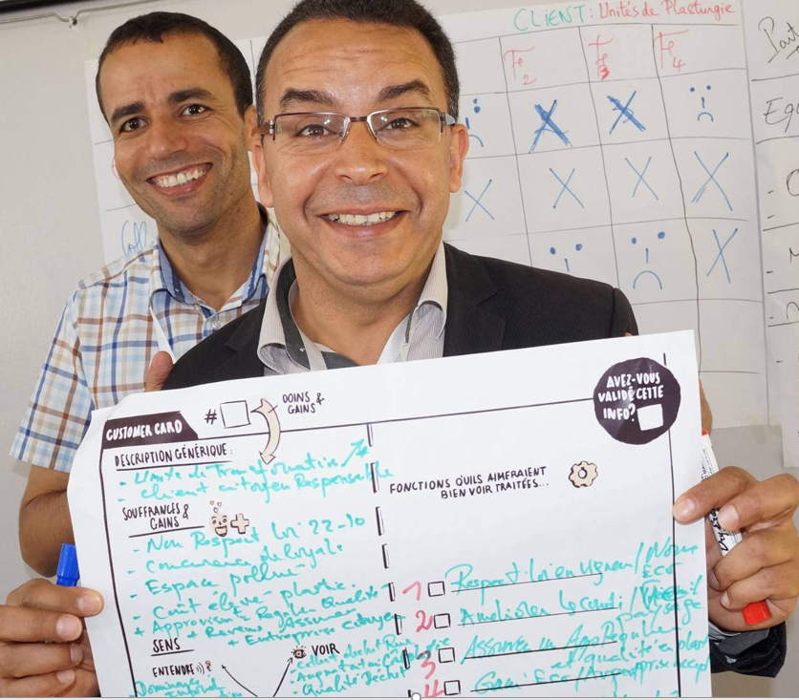
Expected Results
GBM Methodology has been transferred to the Local Trainers (LTs) of the BSOs members of the Switchers National Partnership:
Conceptual contents
Online tool
LTs are able to replicate the training and to support entrepreneurs to move from a business idea to a validated Sustainable Business Model (using the Online Platform). The standard GBM training module consists of 5 intensive face-to-face training sessions (5.5 hours) coupled with a simplified on-line support along a period of 6-8 weeks during which the green entrepreneurs develop their sustainable business model
LTs are able to transfer the GBM Methodology to other members of their BSOs
Notes:
-Replication of the training with green entrepreneurs may be done within SwitchMed programme, GIMED and/or in the framework of BSOs’ support programmes for entrepreneurs.
-A Pedagogical Guide for LT will be available to support entrepreneurs according to SwitchMed format (5-day training along 6-8 weeks) and SCP/RAC staff is also available to support the adaptation to other programmes and formats.

Slide 4
Eco-innovation
A unique and innovative methodology which integrates sustainability into business model development.
National Partnership
The Partnership of BSOs for Sustainable Business Development brings a collaborative advantage.
Interactive Online Platform
The Online Platform no only offers Tools such as the GBM Tool, but also an interactive interface which will allow LTs to:
Plan and schedule trainings, create classes
Contact with entrepreneurs, a class, BSOs…
Check progress of my activities (trainings, incubation…)
Review and comment the content of the GBMs developed by the entrepreneurs.
Added Value

Slide 5
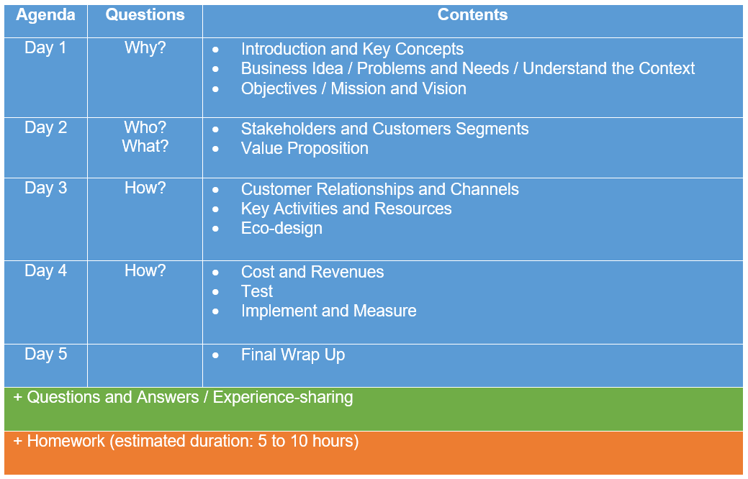
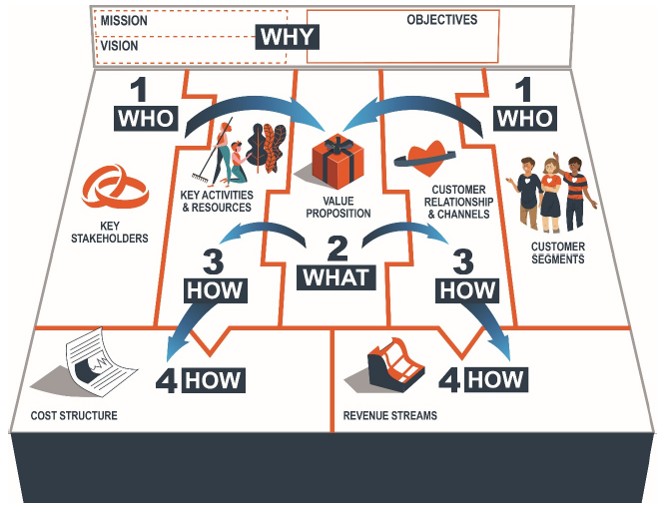
Agenda ToT
Notes:
Work dynamic / general structure of the ToT: webinars and Q&A during the morning and homework during the afternoon (LTs will simulate being entrepreneurs doing the exercises). Final Wrap Up on Day 5

Slide 6
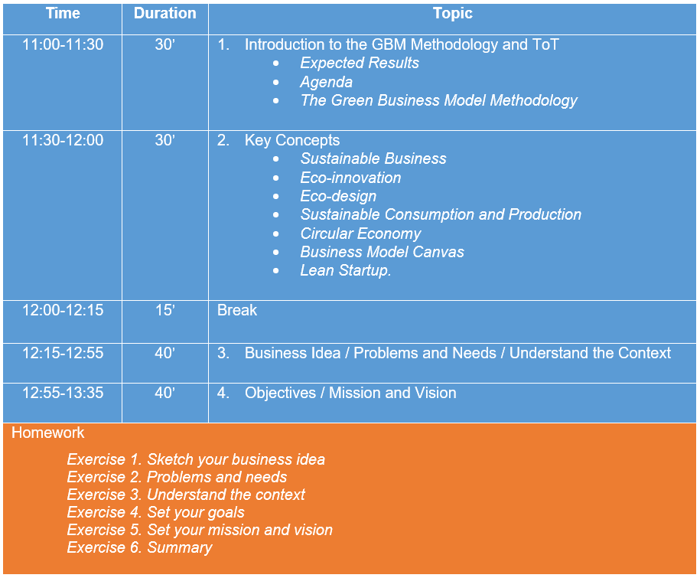
Agenda Day 1

Slide 7
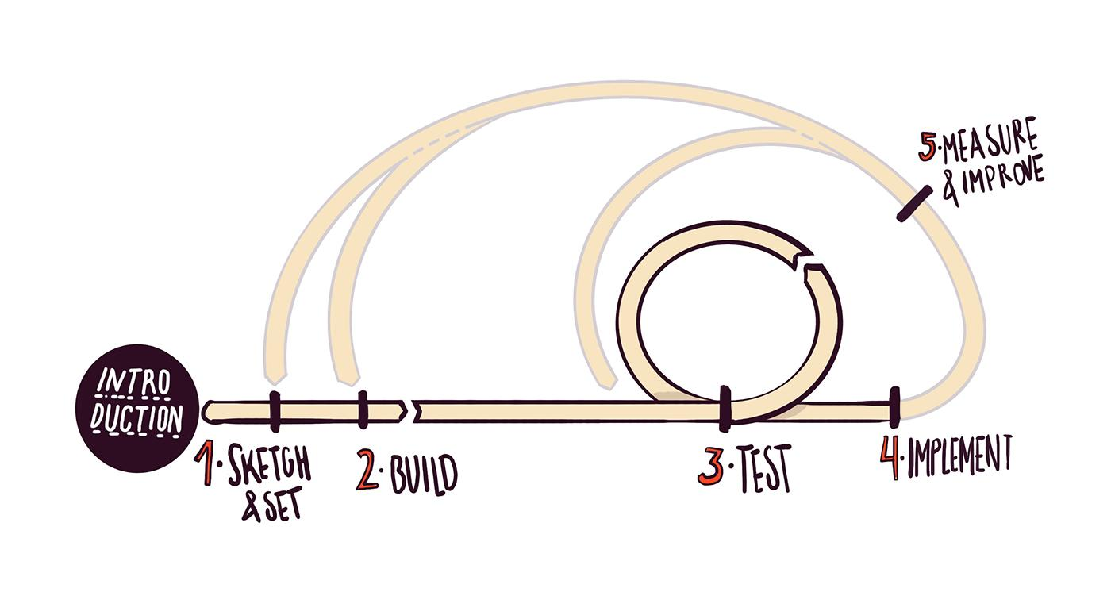
The Green Business Model Methodology
GBM Methodology based on
Business Model Canvas
Eco-innovation
Lean Startup
Online Tool
Online Exercises
Concepts and Content
Business Case Studies
Final deliverable: a validated Sustainable Business Model
Notes:
-The Online Platform LTs will be working with is a beta version. The final version will be available once the training programme targeting GEs will start.

Slide 8

Training Materials
Online Platform: Toolbox
Agenda
Key Concepts Doc
PP Presentations
Notes:
-PP Presentations can be used to undertake GEs’ training with minor adjustments.

Slide 9
2. Key Concepts
Notes:
-For more info see the Key Concepts reference document.

Slide 10
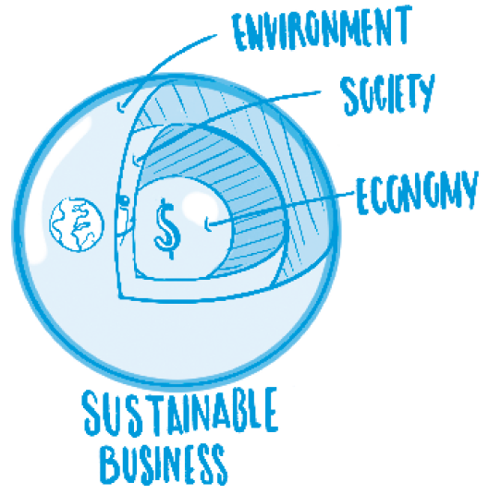
Sustainable Business Model
Brief definition:
A sustainable business provides commercial solutions to environmental challenges which are economically viable and socially empowering.
Comprehensive definition:
Based on the interdependency between the environment, society and economy, a sustainable business pro-vides innovative viable products and services which create environmental value (ad-dressing ecological challenges and reducing environmental impacts) and social value (addressing social needs) by applying eco-innovation, life cycling thinking and eco-design approaches.
Notes:
-A SB not only creates ECV but also EN and SOC value.
-A triple bottom line approach is inherent to circular business models, which are built on the basis of interdependency between the environment, society and the economy. (it broadens the traditional concept of stakeholders: ENV and Society are stakeholders)
-Sustainable business is not only about reducing the negative environmental impacts of a business with regards to its previous practices and/or when compared to other companies within the sector.
-The main purpose of a sustainable business is to create environmental value and produce positive ecological and social impacts. Thus, sustainable business models not only create economic value, through the creation of green companies and employment, but also ecological value by addressing environmental challenges, and social value by addressing social needs.

Slide 11
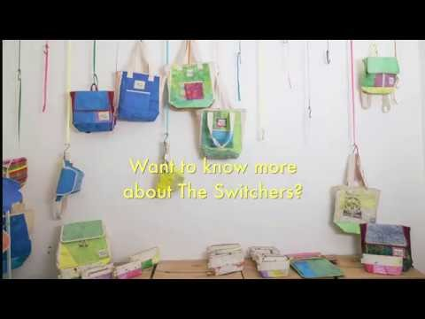
Sustainable Business: example of a Switcher
Notes:
-watch the video.
-The Switchers community: almost 400 Mediterranean sustainable entrepreneurs.

Slide 12
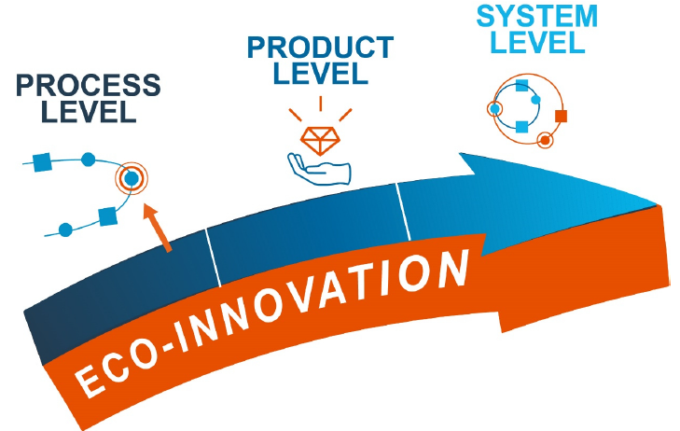
Eco-innovation
Eco-innovation consists in providing new and alternative solutions, which allow a company to reduce its environmental impacts and/or create environmental value.
Notes:
-Process eco-innovation (production processes) increases resource and energy efficiency, saves resources and prevents pollution. E.g. a car manufactured using less raw materials and energy and producing less waste.
-Product eco-innovation changes the main characteristics of the product or service. E.g. shift from conventional cars to electric cars.
-System eco-innovation implies transformations at the system level in the value chain and regarding consumption patterns. E.g. shifting from car production towards offering mobility services through car sharing systems. Even better, bicycle sharing systems could substitute vehicles to cover mobility needs.

Slide 13
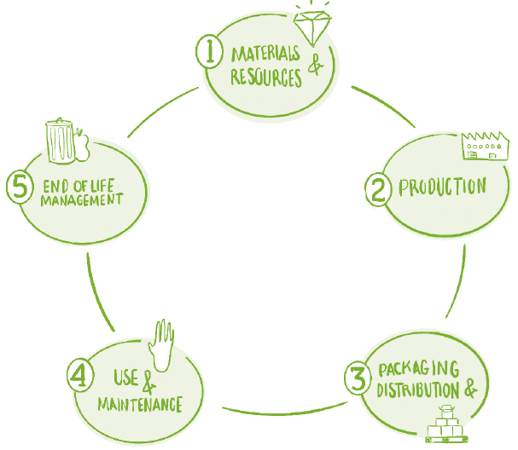
Eco-design
Eco-design consists in taking into account and assess from the design stage (of a product or service and its business model) any potential environmental impact. Impacts on the environment have to be systematically evaluated at all stages of the lifecycle of the product/service: design; extraction and purchasing of raw materials; production; packaging and distribution; sales and marketing, product use; end of life management.
Notes:
-ED is the main tool available for sust. busin. to improve their environmental performance and reduce the environmental impacts of their products and services.
-ED allow us to assess from the design stage all our environmental impacts at all the stages of the lifecycle of our product: extraction and purchasing of raw materials; production; packaging and distribution; product use; end of life management.
-It is usually said that 80% of the environmental impacts are determined during the design phase
Through ED we can assess our impacts and define strategies to improve our environmental performance at each stage of the lifecycle
-ED will also help us to reduce costs (increasing material and energy efficiency)

Slide 14
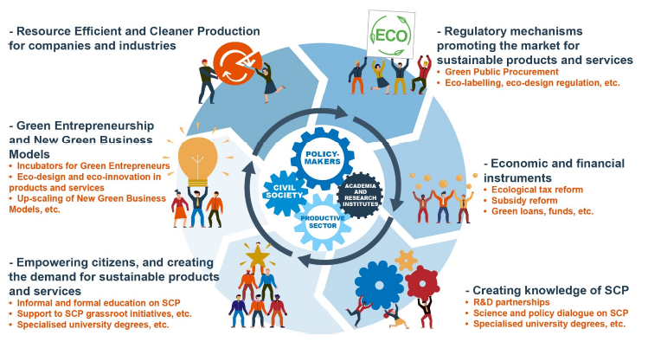
Sustainable Consumption and Production
Adopted by all United Nations Member States: 2030 Agenda for Sustainable Development Sustainable Development Goal 12
SCP is about "the use of services and related products, which respond to basic needs and bring a better quality of life while minimizing the use of natural resources and toxic materials as well as the emissions of waste and pollutants over the life cycle of the service or product so as not to jeopardize the needs of further generations” (Oslo Symposium 1994).
Notes:
-The next two concepts are linked with the policy framework of the Methodology: SCP and CE
-SCP is one of the main global approaches to revert unsustainability of our economic system. Is the goal 12 of the Agenda for Sustainable Development adopted by UN member states.
-SCP is about doing more and better with less. Ensuring quality of life but reducing the use of natural resources and emissions linked with C&P
-SCP require systemic change and should be implemented by various categories of stakeholders:
Policy-makers should adopt regulatory frameworks enabling SCP
Industries must adopt resource efficiency, cleaner production and circular economy approaches
Public and private financial actors have to deploy financial instruments that support SCP
Civil society ought to promote sustainable consumption solutions and demand sustainable products and services
Knowledge of SCP should be developed and disseminated
New companies and start-ups should adopt green and circular innovative business models

Slide 15
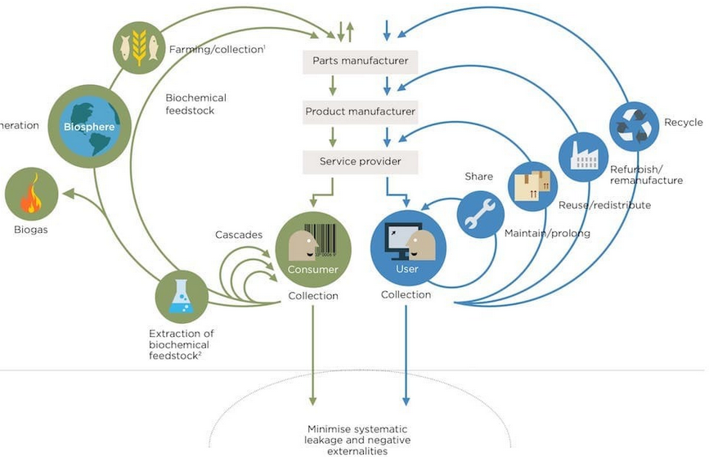
Circular Economy
“Looking beyond the current take-make-waste extractive industrial model, a circular economy aims to redefine growth, focusing on positive society-wide benefits. It entails gradually decoupling economic activity from the consumption of finite resources, and designing waste out of the system. Underpinned by a transition to renewable energy sources, the circular model builds economic, natural, and social capital. It is based on three principles: Design out waste and pollution; Keep products and materials in use; Regenerate natural systems” (Ellen MacArthur Foundation).
Notes:
-CE is about shifting from a take-make-waste economic model to a circular model which decouples economic activity from resource consumption and waste/emissions.
-3 basic principles: design out waste and pollution; keep products and material in use; regenerate natural systems
-The model distinguishes between technical (recover materials) and biological cycles (regenerating living systems)
-EU Circular Economy Action Plan - one of the main blocks of the European Green Deal

Slide 16
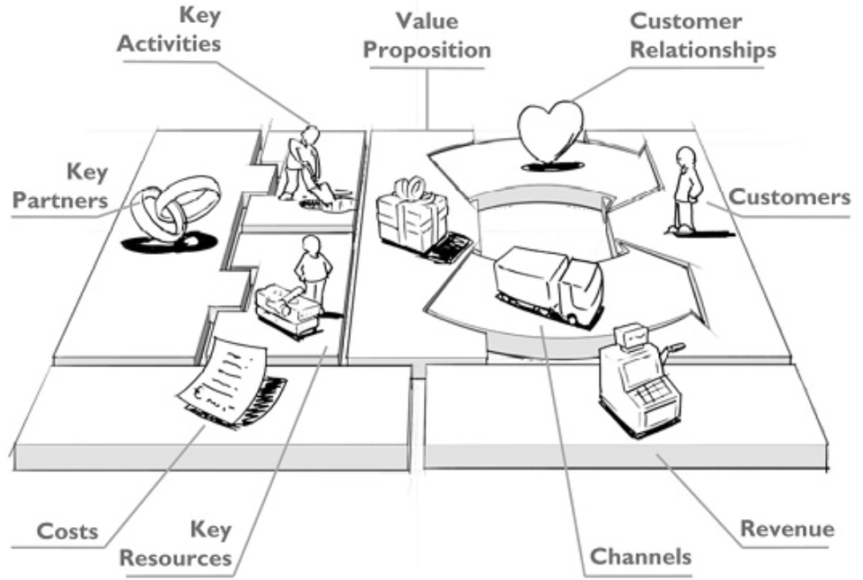
Business Model Canvas
“A business model describes the rationale of how an organization creates, delivers, and captures value” (Osterwalder and Pigneur).
A business model can be synthetized and described through a Business Model Canvas and his building blocks
Notes:
-The next two concepts are linked with the methodological approach of the GBM tool: BMC and Lean Start-up
-BMC has been proposed by Osterwalder and Pigneur and describes the VP of a company and how value is created, delivers to the customers and captured by the company.
-BMC describe a business model in a synthetic way identifying its major building blocks: VP, key partners and customers, key activities and resources, customer relationships and channels, costs and revenues.
-The GBM metho has adapted the BMC to a triple bottom line approach and adding environmental and social value creation and distribution.

Slide 17
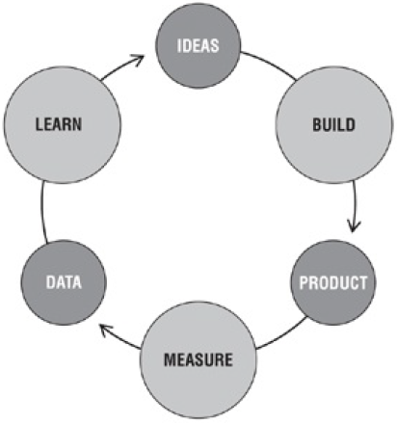
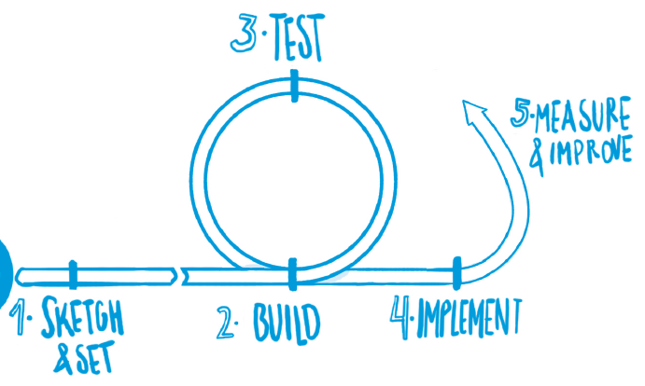
Lean Startup
Lean Startup approach encourages entrepreneurs to test their business models and product/service from the very beginning, looking for feedback from potential customers and early adopters and continuously adjusting the idea according to the reactions. The approach can reduce costs, risks and time to validate a business model.
Build-measure-learn feedback loop (Ries: 2011)
Notes:
-The other approach that we adopted for the development of the tool is the LS.
-Most new business tend to fail, mostly because they don’t find customers.
-The LS approach considers that this mainly happens due to a lack of testing of the assumptions underlying the business model
-The approach encourages entrepreneurs to test their business model from the very beginning, looking for feedback from potential customers and other stakeholders
-Hypothesis and assumptions are continuously tested, gathering feedback and adjusting the idea
-This way we can reduce costs, risks and time

Slide 18
3. Business Idea Problems and Needs
Understand the Context

Slide 19
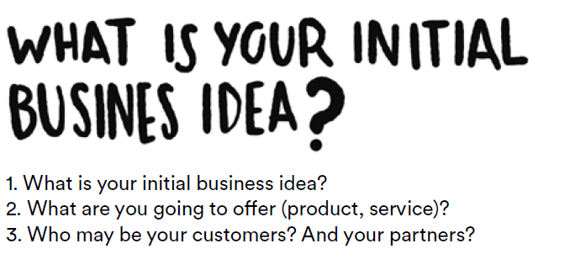
Business Idea
1st step of the GBM methodology: explain our green business idea. The purpose is to understand the main components of the idea and prepare the work ahead
Very first approach to problem-solving which will be improved later on
Notes:
In Exercise 1 on the Online Platform we have to briefly describe our initial green business idea.
Here we set a starting point from which developing further our business model. It’s a very first draft which will be improved progressively
Entrepreneurs have to fill in 4 boxes in the platform:
Describe the initial Business idea
Describe the Product/service they want to offer
Describe who will be their customers
Describe which Partners they need to involve to develop the business

Slide 20
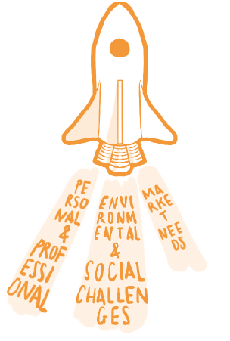
Identify Problems and Needs
Drivers
Understanding the reasons that drive the project and its founders, is essential to establish a sense and purpose to the whole process of green business creation. Four driving forces can be distinguished:
External forces:
Environmental challenges/problems
Social challenges/problems
Market/customer needs
Internal forces:
Personal and professional motivations (team)
Characteristics of entrepreneurs
Goals and personal motivations
Commitment/availability team
Notes:
In Exercise 2 on the Online Platform we have to identify the main drivers of the green business project. The meth considers 4 main driving forces which have to be defined, 3 are external and 1 is internal:
briefly describe these 4 drivers:
Env challenges/problems that we want to address
Soc challenges/problems that we want to address
Customers needs
Team motivation

Slide 21
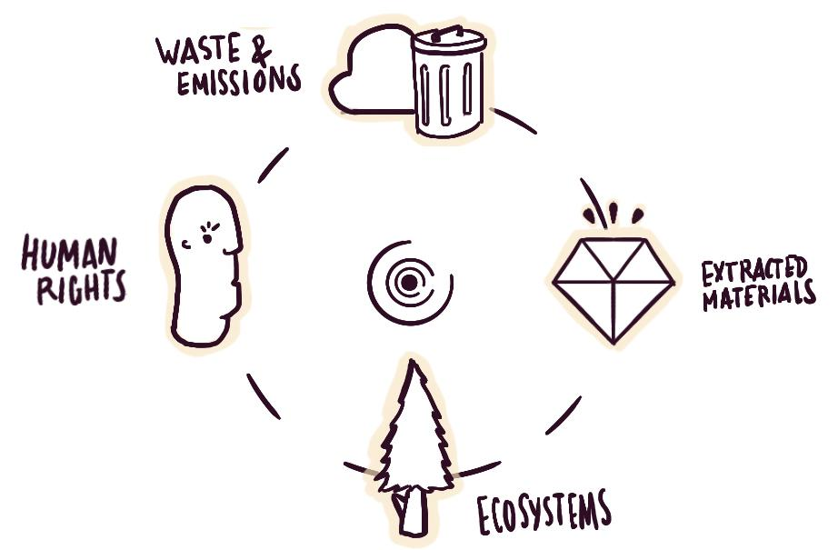
Identify Problems and Needs
Environmental and Social Challenges
System Boundaries. Boundaries are the human and natural system conditions for sustainability, that any business, industry or society need to comply for sustaining life and for ensuring their development in the long term. These boundaries, in practice, are the limits that our planet sets to any activities taking place on it.
Environmental and social challenges lie at the core of a green business. Which challenges are addressed by our project? (We have to support the existence and relevance of the challenges with data/evidence)
Notes:
-We start with ENV and SOC challenges.
-Here the GE has to understand that no business exists in isolation, that they are part of a context, of natural and social systems and an ecosystem of actors. The context can affect our business and be affected by it. The context also defines our natural and social boundaries.
-Within this context we will identify the ENV and SOC challenges that we want to tackle through the business
-For a sustainable business, of course ENV and SOC drivers are crucial, they are the raison d’être of the project. GEs should therefore spend enough time to properly and effectively identify these drivers. It is also recommended that the identification of challenges is supported by data and evidence. We have to ensure we address real and appropriate ENV and SOC challenges.

Slide 22
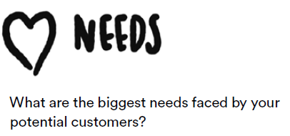
Identify Problems and Needs
Market Needs
Identify unfulfilled needs and market opportunities. Business opportunities linked to environmental and social challenges.
If the contribution to a healthier environment and a fairer society make up the mission of a sustainable business, customers are the gears that make its economic engine turning.
Preliminary information about market and trends and needs.
We should focus on our clients: understand their needs, values, etc.
Notes:
-Next driver is crucial for the viability of the project, since without customers the business will simply fail
-In this step GE have to identify market needs which are linked with the ENV and SOC challenges previously identified
-They should find needs which are not effectively covered and therefore offer market and business opportunities
-Identification of needs is crucial. Without customers the business will not be economically viable
-Is therefore vital to focus on our clients from the very beginning, to put ourselves in their shoes, trying understand their needs, what they want, how the feel, etc. and test from the very beginning, consulting potential clients and looking for their feedback adjusting our initial idea.

Slide 23
Identify Problems and Needs
Personal and professional motivations
(team)
Entrepreneurs must know themselves and their teams. Aligned personal and professional goals, complementarity of skills, balanced levels of commitment and honesty/transparency are all ingredients of the success of the green business.
Goals and motivations:
Autonomy
Purpose
Flexibility
Economic success
Legacy
…
Characteristics of entrepreneurs:
Passion
Risk tolerance
Independent thinking
Optimism
Self-confidence
Problem solvers
Action oriented
Tenacity
Vision
Focus
Commitment:
Level of commitment
Availability
Dedication
Work-life balance
Notes:
-Finally, internal motivations of the GE and the team are also an essential driver of the business.
-A lot of companies tend to fails because of tensions and misunderstandings within the team, because of unaligned motivations or commitment, etc..
-Therefore, we have to ensure that motivations are properly aligned, and skills and commitment are well balanced and that all these aspects are clear for everybody within the team.
-Some of the aspects GE should think about are linked with goals and motivations, characteristics of entrepreneurs and levels of commitment.

Slide 24
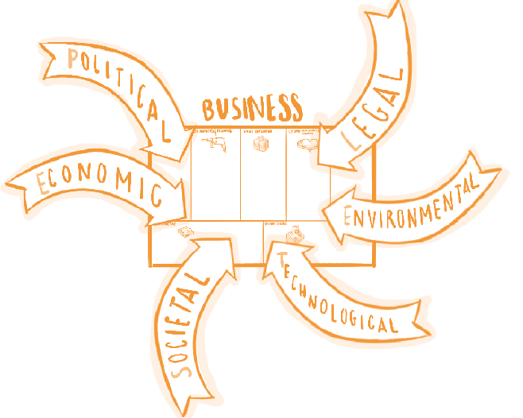
Understand the context
Like everything else, a business is part of a system. It operates in a context and is affected by Political, Economic, Social, Technological, Environmental and Legal (PESTEL) aspects.
Foresee opportunities and avoid potential threats caused by long term changes and trends.
Local, regional and global context/level (start locally and widen the scope).
For a sustainable business, particular emphasis will be put on environmental factors.
Notes:
_Next step (exercise 3) is linked with understanding the context
-As we said a business, like everything else is part of a context and is therefore crucial to assess how the context can affect us
-In exercise 3 GE have to undertake a PESTEL analysis, assessing opportunities and threats linked with the main elements of our context: 6 aspects
-By doing so we will start to think locally and the widen the scope to national, regional and global context if needed.
-Of course, being a sustainable business, we should focus specially on environmental aspects

Slide 25
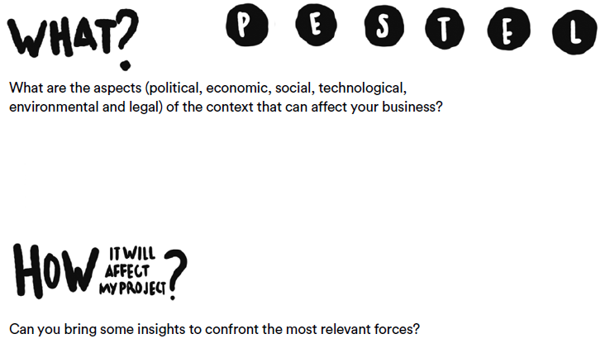
Understand the context
PESTEL
Some questions to be asked:
What is the political situation of the country and how can it affect our business?
What are the prevalent economic factors?
How much importance does culture has in the market and what are its determinants?
What technological innovations are likely to pop up and affect the market structure?
What are the main environmental concerns and challenges?
Are there any current legislations that regulate our business or can there be any change in the legislations for our business
Brainstorm, prioritise (5) and confront
Notes:
-In Exercise 3, for each of the 6 aspects we have to identify them (what? box) and describe how they will affect our project (how? box).
-PESTEL analysis requires information research in order to bring any relevant insight (reports, interviews, etc.)
-The meth recommend to analyse all the aspects but to finally prioritise 5 main elements

Slide 26
4. Objectives
Mission and Vision

Slide 27
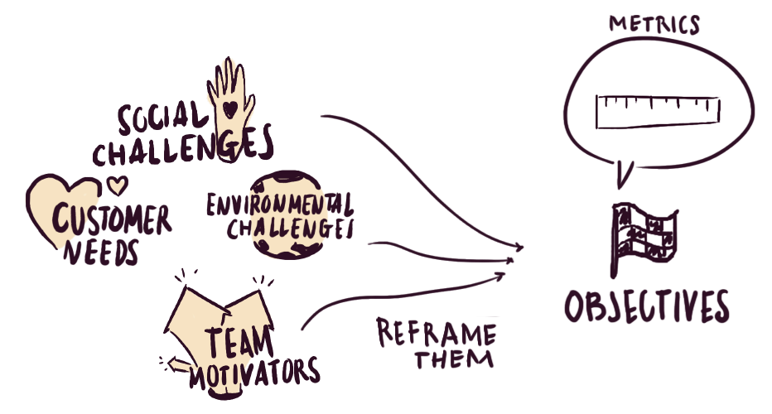
Objectives and Indicators
Having understood the context our business operates in (system boundaries and forces of change), as well as the drivers behind it (personal and professional motivations, environmental & social challenges, and customer needs); we now find ourselves ready to set the objectives (by tackling the drivers) that will guide us towards the impact we want to leave behind.
To chart a path towards our vision, drivers are translated into company’s objectives and tracked by indicators
Notes:
-At this point we have analysed the context in which our business operates
-and the 4 main drivers of our project
-We are now ready to set the objectives of our green business

Slide 28
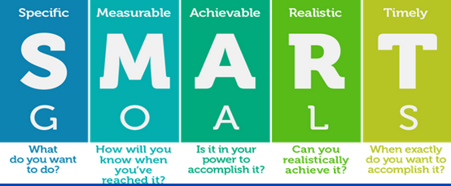
Objectives and Indicators
Objective: it refers to what the entrepreneurs wants to achieve with the green company in relation to the problems and needs already identified.
Indicators: the Impact Monitoring Tool within the Online Platform offers a set of indicators by sectors according to sustainable businesses goals
Notes:
-Objectives are what the GE wants to achieve through his sustainable business in relation with the 4 main drivers: ENV and SOC challenges, Customers needs and Team Motivators
-Objectives (and associated indicators) have to be SMART:
Specific in defining what we want to achieve
Measurable in order to monitor achievements
Achievable (reaching the objectives is in our hands?)
Realistic (it is realistic to reach the objectives?)
Timely (when will it be reached?)

Slide 29
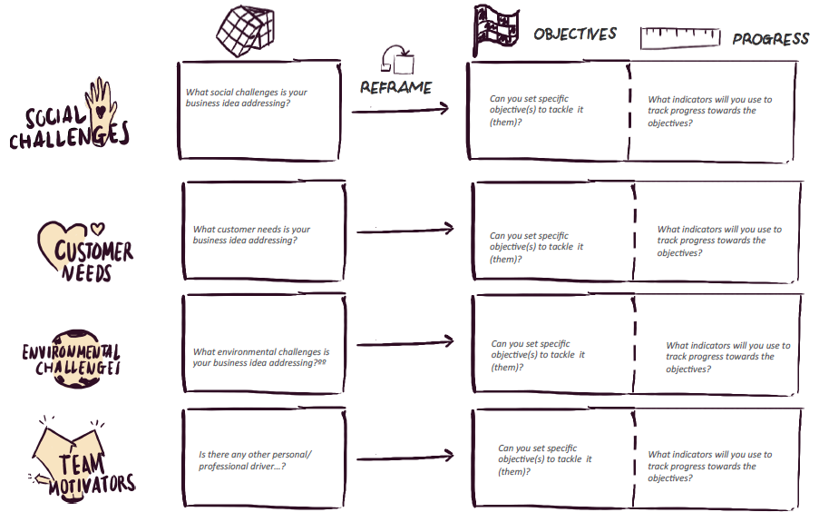
Objectives and Indicators
Recap: capture the most relevant problems and needs that your project is seeking to tackle
Set objectives: reframe the problems and needs into specific objectives to solve or confront them
Measure progress: set indicators to measure the progress towards objectives (optional at this stage)
Notes:
-In Exercise 4 on the Online Platform, we will have to reframe each one of the 4 identified drivers (Env challenges, Soc challenges, Customer needs, Team motivators) into Objectives (Indicators are not yet set in the exercise but we can start to think about it).
-For each driver, in the 1st box we will have problems we identified, and in the following box we will have to reframe it into an objective
-identified problems and needs become Hypothesis that underpin the Objectives. Theses hypothesis will have to be tested to validate our business model.

Slide 30
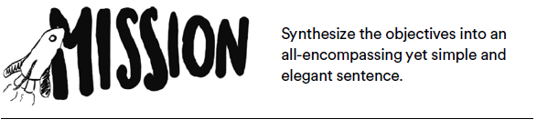

Mission and Vision
By merging and synthesising the objectives into a single, short and elegant statement, we build our project’s mission, which must embody its essence and reason for being. The vision, in turn, comes naturally as a time instance of the mission: the way we envision our project in the mid-long term
Notes:
-Once the objectives are defined, in the following exercise (5) we will define our M and V
-M: we can define our M by merging and synthetize our objectives into a single sentence
-V: we can define our V imaging our business in the mid-long term according to our M

Slide 31


Mission and Vision
Short statement of why an organization exists, what its overall goal is:
What kind of product or service it does provide,
Primary customers or market, and
Geographical region of operation
Provides guidance about what core to preserve and what future to stimulate progress toward. Two major components:
Core ideology - what we stand for and why we exist.
Envisioned future- what we aspire to become, something that will require significant change and progress to attain.
Notes:
-In Exercise 5 on the Online Platform we will have to draft a first version of our Mission and Vision.
-We have to make sure that the environmental and social objectives which we identified in the previous exercise are included in our Mission sentence
-In synthetizing a Mission and a Vision, we must keep in mind that the environmental and social objectives are the main purposes of our business, unlike traditional businesses whose primary goal is the maximisation of profit. At the same time, in order to reach our environmental and social objectives, our business should be financially sustainable and profitable so real customer needs should be embedded in our M and V.
-In Exercise 6 a Summary of Step 1 will recap main elements developed so far: Problems and needs identified, Objectives of the business, PESTEL analysis of the context, Mission and Vision. At this point we will have to review them and reframe them if needed.

Slide 32
Mission and Vision
Examples (M and V can be business centred, inspirational, peoples’ centred…)
Triodos Bank (www.triodos.com):
M - Make money work for positive, social, environmental and cultural change.
V - Triodos Bank enables finance progressive entrepreneurs and influence the banking sector to become more transparent, diverse and sustainable.
Patagonia (www.patagonia.com):
M - We’re in business to save our home planet.
V - Build the best product, cause no unnecessary harm, use business to inspire and implement solutions to the environmental crisis.
Notes:
-We can have a look to some example of M and V of sustainable companies.
-Tomorrow we will have a look to the Value Propositions of these same sustainable companies.

Slide 33
Mission and Vision
Examples (M and V can be business centred, inspirational, peoples’ centred…)
Fairphone: (www.fairphone.com)
M - To build a fairer and more sustainable electronics industry.
V - Set new standards for the entire industry where consideration for people and the planet is a natural part of doing business.
ECOALF: (https://ecoalf.com)
M - We are passionate about putting an end to using natural resources in a careless way.
V - We create clothing, footwear and accessories made entirely from recycled and sustainable materials with the same quality, design and technical properties as the best non-recycled, non-sustainable products.
Notes:
-We can see in the examples, and we should stress with GEs, that ENV and SOC objectives are the core content of M and V of a sustainable business.
-Stress systemic change (transformation of the value-chain, industry, sector… through the eco-innovations of the green businesses). Collective effect of all Switchers in achieving systemic transformation needed to face environmental crisis.

Slide 34
Homework:
Exercise 1. Sketch your business idea
Exercise 2. Problems and needs
Exercise 3. Understand the context
Exercise 4. Set your goals
Exercise 5. Set your mission and vision
Exercise 6. Summary
Notes:
Put yourself in green entrepreneurs’ shoes and fill in the exercises!

