Slide 1
Green Business Model Training of Trainers Country – Session 2
Trainer 1 xxx@mail.com
Trainer 2 xxx@mail.com
BSO

Slide 2
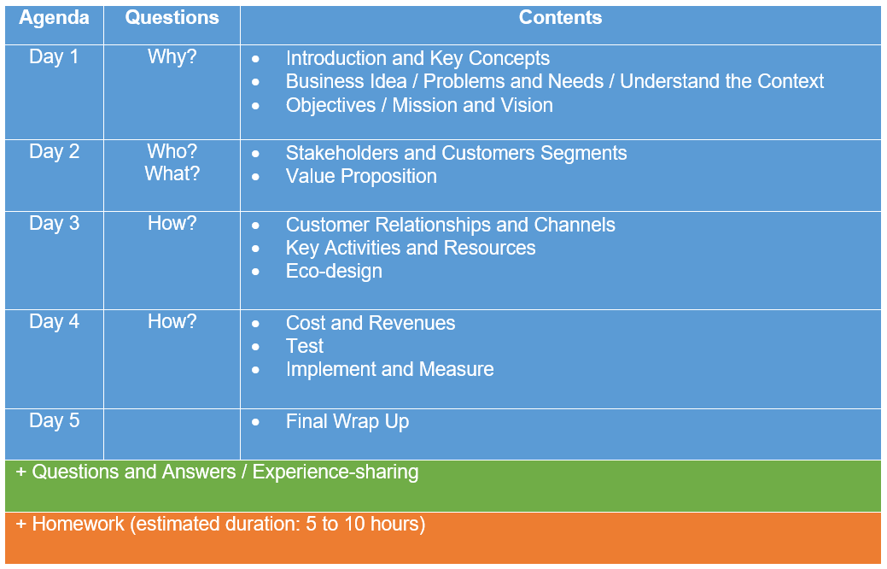
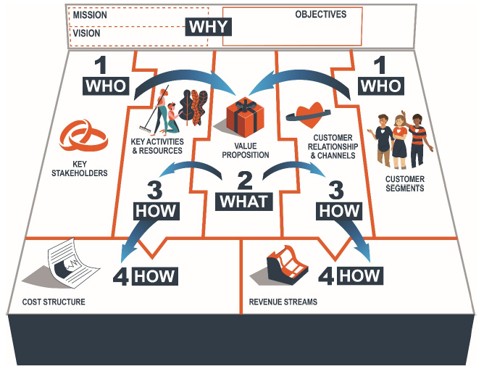
Agenda ToT

Slide 3
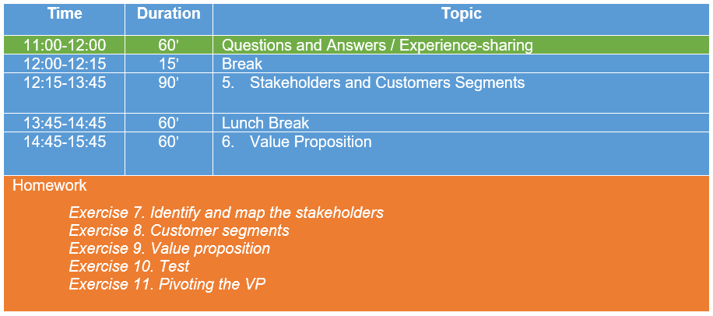
Agenda Day 2

Slide 4
Questions and Answers
Experience-sharing

Slide 5
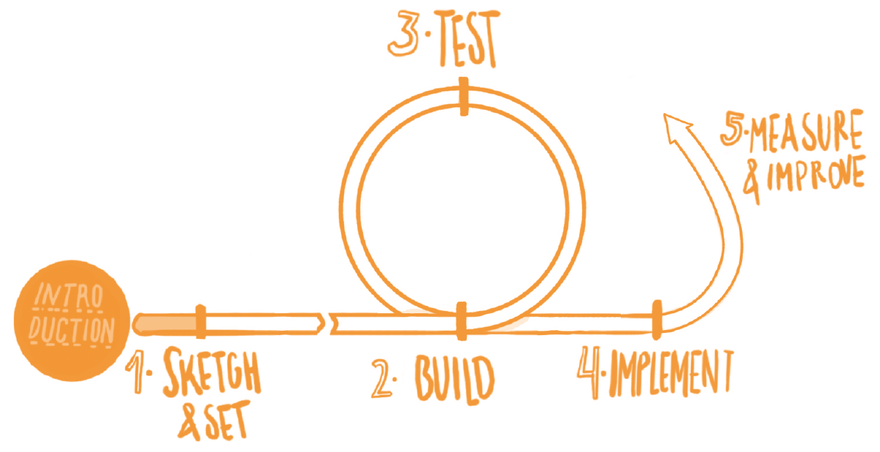
Methodological reminder
GBM as central design tool in each iteration with 4 main areas:
Who?: Stakeholders and Customers Segments
What?: Value Proposition
How?: Customers relationships and channels, and key activities and resources
How?: Cost structure and revenue stream
Green business’ direction has been set (Why?)
Now let’s start building the GBM by mapping Stakeholders and Customers Segments (Who?) and co-creating with them our Value Proposition (What?)...

Slide 6
5. Stakeholders
Customers Segments

Slide 7
Stakeholders
Agents or groups related to the project, either because they are influenced/affected by its objectives or, the other way around, they exert an influence/effect on them, or both.
Customers are a special stakeholder in the sense that the financial health of the project relies on their engagement, and so they deserve special attention.

Slide 8
Engaging with Stakeholders
The ecosystem of actors (stakeholders) plays a fundamental role in achieving a business’ objectives, including the team, partners, beneficiaries, customers, suppliers, investors, the media, NGOs, local communities, society at large, the Planet, etc. By engaging them in the project we are able to create the project’s environmental and social value.
We can achieve this by:
Mapping them and assessing their influence in our project
Assessing the gives & gets in our relation

Slide 9
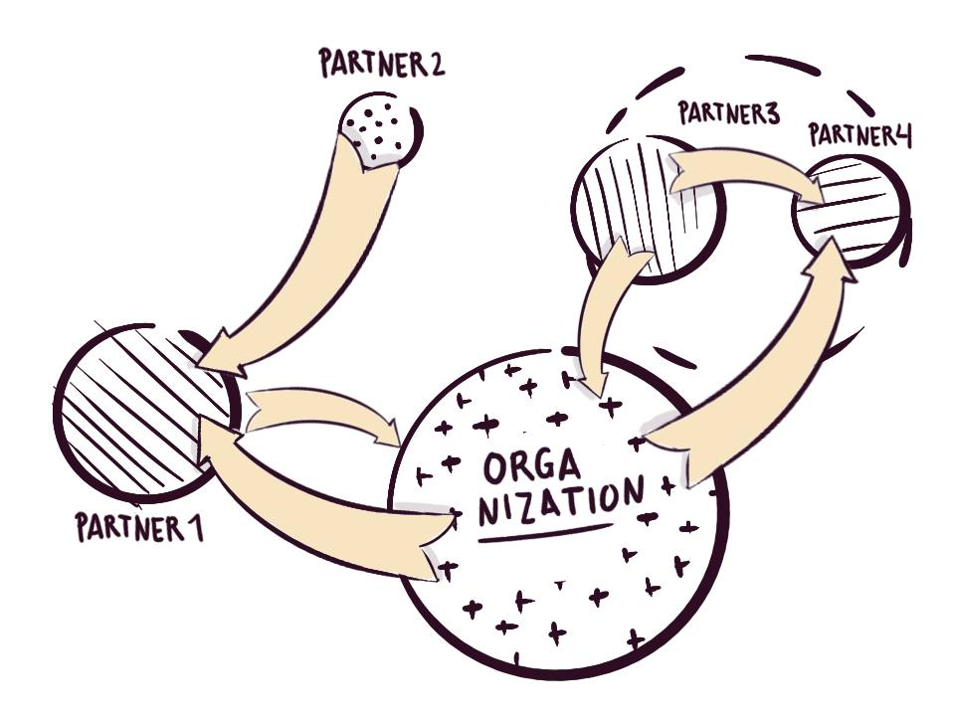
Stakeholder Mapping
Mapping: identifying and prioritizing stakeholders that will play a significant role in achieving the objectives of the project. First, identify all the actors related to each objective, and then select the most relevant ones for the whole project (i.e. involved in most objectives). Some of the most relevant key stakeholders include:
Team
Partners
Beneficiaries and Customers
Local community

Slide 10
Beneficiaries and Customers
Beneficiaries: Benefit from the value your project generates, though they might not be the one to pay for it. Is the one who derives the main benefits that are linked to the social mission of your business.
Customers: Particular type of beneficiaries that lie at the core of your business. They are willing to pay for your services or products (vehicles of value), thus acting as the main catalysts for the monetary flow around the project’s ecosystem.

Slide 11
Enhance our Social Value
Stakeholder identification and engagement is a key step to enhance the social value creation of our Sustainable Business.
Local community: Our project’s main impact in society has to be intrinsically linked to the local community, which refers to the geographical area where we operate and deliver: creation of local employment, contribution to awareness-raising and education of the local population, partnerships with neighbouring businesses and public administration, green and proximity procurement, etc. We have to make sure to engage local communities in the co-creation of our GBM and that the business idea doesn’t adversely affect local communities’ interests such as access to material resources (e.g. water and other natural resources).
As identifying potential providers let’s prioritize sustainable and social businesses and non-profit organizations as well as local suppliers.
Prioritize the engagement of stakeholders representing vulnerable people and marginalised groups. Adopt a gender perspective while identifying and engaging stakeholders.

Slide 12
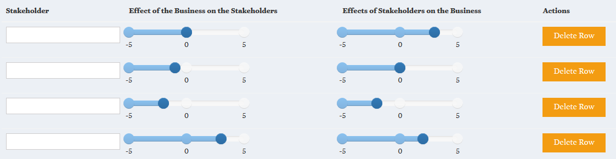
How to perform Stakeholder Mapping?
Identify and list the stakeholders that may influence your project’s objectives or may be affected by them. Can you give the names of real actors and organizations?
Rate the level of influence they have on your project and the extent in which they are affected by it (“give & get” exchanges).
Notes:
-Let’s move to Step 2. on the Online Platform. In Exercise 7, for each group of objectives (Env./Soc./Customers needs/Team motivators) we will have to identify relevant stakeholders which may influence our project or be affected by it. For each set of objectives, we can add rows for additional stakeholders. For each stakeholder we have to rate “from -5 to 5” the effect of the business on the stakeholder as well as the effect of the stakeholder on the business.

Slide 13
How to perform Stakeholder Mapping?
Stakeholders are then distributed on a matrix on the Online Tool according to the levels of mutual influence.
Notes:
-Once exercise 7 is completed for all objectives and related stakeholders, a matrix will be automatically generated.

Slide 14
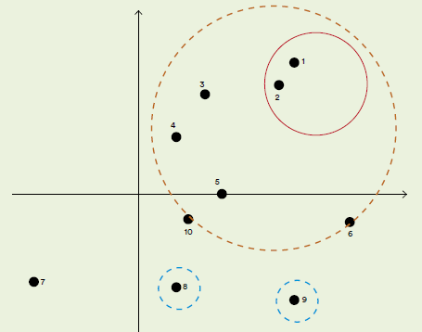
How to perform Stakeholder Mapping?
The right-top quadrant will concentrate the most relevant stakeholders.
Prioritise the key stakeholders, narrowing them down to not too many so that we lose focus, but not too few so that the models works.
Unthought-of key stakeholders may emerge later.
Notes:
-Right bottom quadrant concentrate stakeholders which may be associated to relevant risks for our project.
-Left top quadrant concentrate stakeholders which may be associated to relevant opportunities for our project.
-We have to consider if involving or not the ones associates to the biggest risks and opportunities.
-For each one of the stakeholders selected as most relevant, by clinking on their point in the chart we will be able to fill a card “assessing the gives and gets” (Exercise 7b).

Slide 15
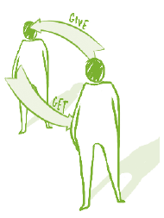
Assessing the gives and gets
Once identified and mapped, we can start previewing the kind of relationships, or “give & get” exchanges (contribution/reward), that should take place among them for the equation to be properly balanced. Those exchanges of value require validation in reality through market tests and feedback gathering. The true value of stakeholder engagement, besides ensuring participation, resides on the power of co-creation. “Co-creating” a project means jointly designing and executing it together with the key stakeholders, as a way to empower them on the one hand, and maximizing the value created on the other. Co-creation should start right from the start.
Notes:
-In Exercise 7b we assess the gives and gets for the stakeholders selected as most relevant:
Who? – Importance
Gains?
Influence on our business
Client?
How to engage them?

Slide 16
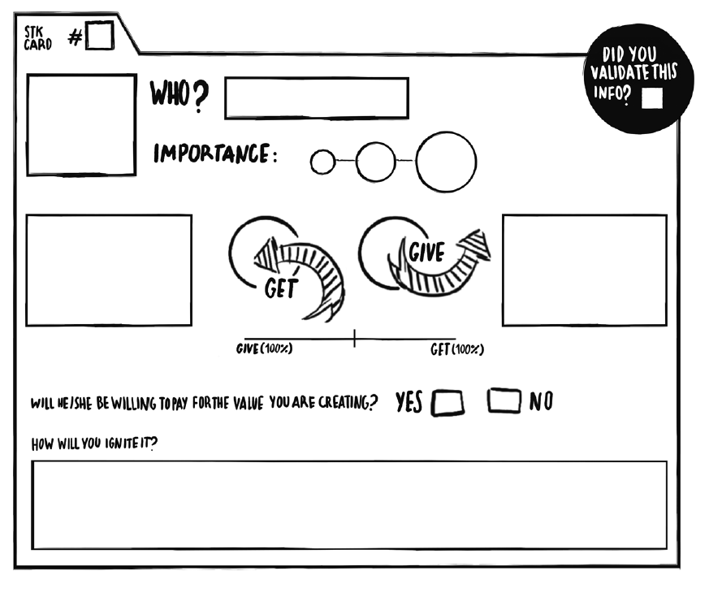
Gather information
Gather information (through individual interviews, surveys, focus groups…) and guess. Fill a stakeholder card on the Web Platform for each of the relevant stakeholders, from the most relevant to the least.
Assess the gives & gets, and determine a balance
Identify those inclined to paying for the value you are creating
Think a way to engage them!
Notes:
-In Exercise 7b we assess the gives and gets for the most relevant stakeholders:
Who? – Importance
Gains?
Influence on our business
Client?
How to engage them?
-The list of the most relevant stakeholders will be copied in the corresponding block of the canvas.

Slide 17
Customers
Customers are a special type of beneficiaries (stakeholders), one that receives value from the project through the purchase of its services or products, they are thus the master key for economic and financial viability.
Three factors usually converge in the making of a customer:
Ample value creation (perception and reception)
Unique offer in the market (differentiation)
Adequate price (affordability).
This step will require reviewing the previously performed stakeholder map and identify those beneficiaries willing to pay for the value the entrepreneur is creating.

Slide 18
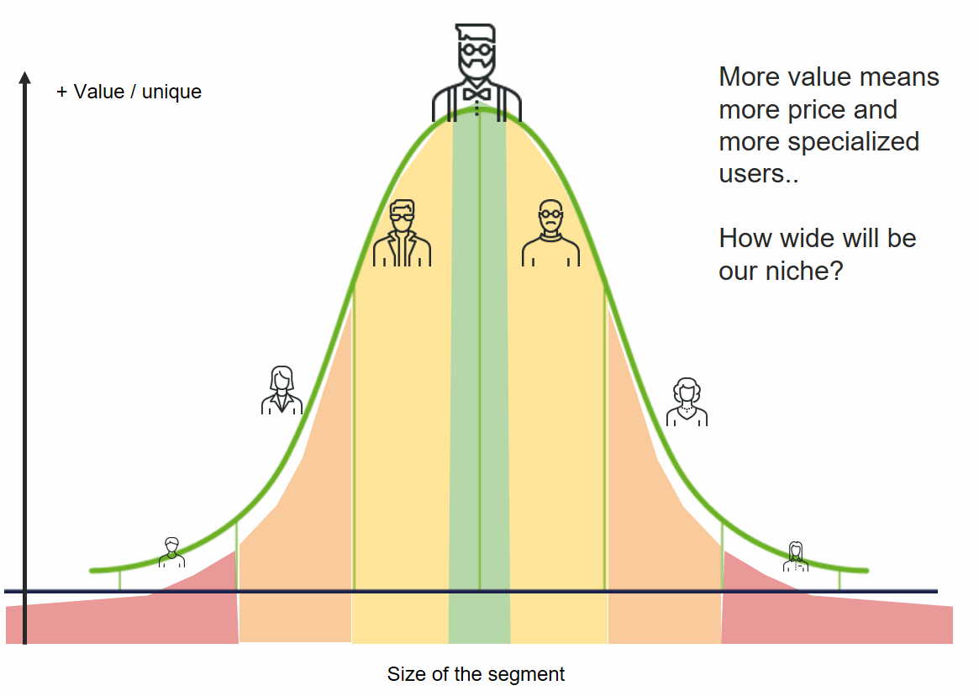
Customers
When we enter a market, we first need to study it (market assessment) to decide whether to:
Focus on a niche of it (segment), or
Open new uncontested market space where competition is irrelevant (Blue Ocean Strategy).
Customers willing to pay for a prototype (an early version of the product or service offered) are called ‘early adopters’.
Niche can be broad or targeted:

Slide 19
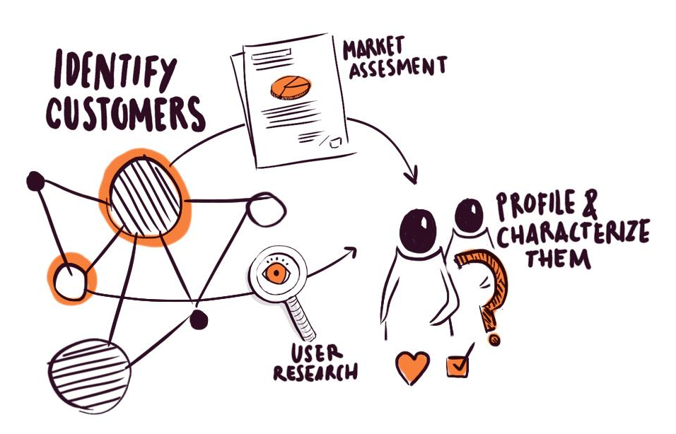
Customer Segments
The goal at this point is to develop a sound understanding of our potential customer base (customer identification and profiling) and the existing market around it (market assessment), upon which to ground our business model design choices.
Once completed, decisions regarding segmentation (selecting customer segments) and positioning (differentiating our approach with respect to the competition's) might be made. All this customer value will then be transferred into the core of our business via the value proposition.

Slide 20
Customer
Segments
Customers segments: homogeneous groups of customers whose behavior, demographic, economic and other characteristics are similar.
Through segmentation it is possible to evaluate groups of customers in terms of the revenue they generate and the costs of establishing and maintaining relationships with them.
It also helps companies determine which segments are the most and least profitable so that they can adjust their marketing budgets accordingly.
Different approaches, for example: B2B companies or B2C companies
Social Value of our business: adopt an inclusive approach while selecting our customer segments by including a diversity of profiles (e.g. groups in risk of social exclusion, disadvantaged and particularly vulnerable people, etc.)

Slide 21
Customers’ Profiling
Once potential customers have been identified it’s time to know them closely in order to pinpoint their needs. We will perform it in two layers of detail:
A generic description based on broad demographic statistics
A personal map of functions to be fulfilled (customer jobs), and emotions felt (pains & gains and senses).
If we want to unlock our customer’s personal connections with our project, we need to put ourselves in the shoes of our customers to think, say and feel quite as they do. This sets the boundary conditions for understanding and eventually engaging them.

Slide 22
Customers’ Profiling
Generic description: A descriptive portrait of the customer. It could include: data on the geographical area where they are located, their typical jobs, age range, living expectations, connections with the rest of the world, etc.
Customer functions: A description of the tasks they are trying to perform and complete, the problems they are trying to solve, or the needs they are trying to satisfy. The needs speak more to our minds and rational motivations.
Pains: Negative emotions, fears, undesired costs and situations and risks your customer experiences or could experience before, during, and after getting the functions done.
Gains: Benefits the target customer expects, desires or would be surprised by. They include functional utility, social gains, positive emotions, and cost savings.

Slide 23
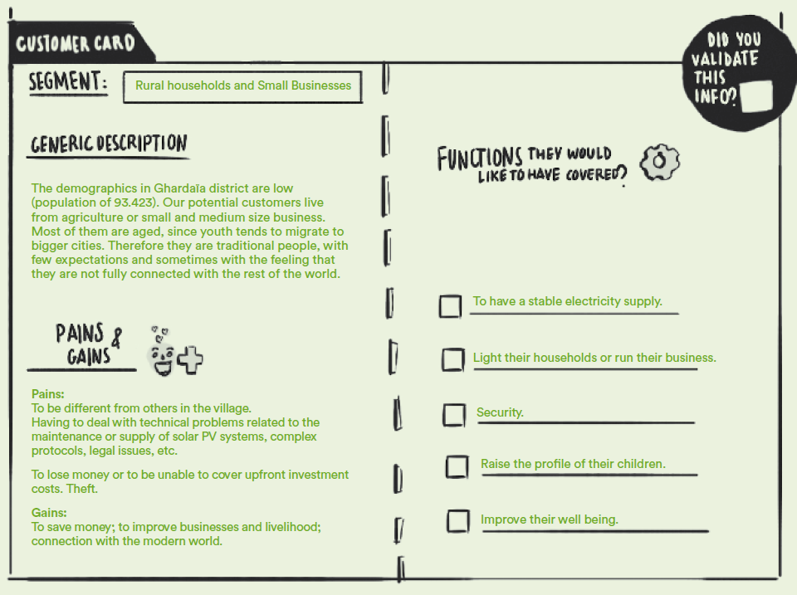
Customers’ Profiling
For each of the relevant customers fill in a Customer Card on the Web Platform (with the data from performed interviews, surveys, focus groups...)
Notes:
-In Exercise 8 on the Online Platform, we will have to fill in for each customer segment:
description
pains
gains
functions they would like to have covered

Slide 24
6. Value Proposition

Slide 25

Value Proposition
This is the moment to concrete your business idea, and generate an unique and rich value proposition, that could be introduced to market with the aim of generating social and environmental value, as well as allowing you to achieve your objectives.
Focus on:
Environmental and social value
Analyse the market (underline opportunities according to your advantages, or focus on your better value proposition in relation to the competence)
Engage your clients and stakeholders through co-creation processes.

Slide 26
A unique
Value Proposition
A value proposition is a promise of value to be delivered, communicated, and acknowledged.
It should convince a potential customer why your service or product will be of more value to them than similar offerings from your competition.
Explains how your product solves customers' problems or improves their situation (relevancy), ... tells the ideal customer why they should buy from you and not from the competition (unique differentiation).
Explains how environmental and social value are created tackling ecological challenges and addressing social issues
A good value proposition will be concise and easy to understand.

Slide 27

A unique
Value
Proposition
Notes:
M - We’re in business to save our home planet.
V - Build the best product, cause no unnecessary harm, use business to inspire and implement solutions to the environmental crisis.

Slide 28



Notes:
M - We are passionate about putting an end to using natural resources in a careless way.
V - We create clothing, footwear and accessories made entirely from recycled and sustainable materials with the same quality, design and technical properties as the best non-recycled, non-sustainable products.

Slide 29



Notes:
M - Make money work for positive, social, environmental and cultural change.
V - Triodos Bank enables finance progressive entrepreneurs and influence the banking sector to become more transparent, diverse and sustainable.

Slide 30

Same Product, Unique
Value
Proposition
Notes:
Iphone, Samsung, Fairphone

Slide 31
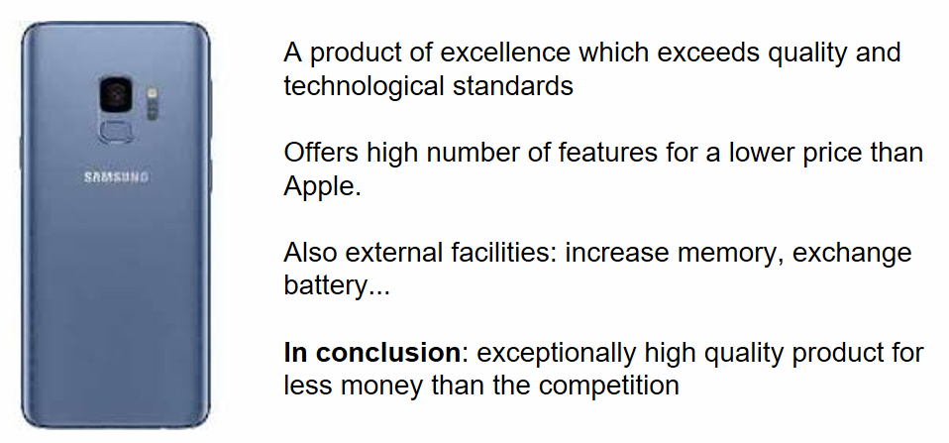
Same Product, Unique
Value
Proposition
Notes:
Iphone, Samsung, Fairphone

Slide 32

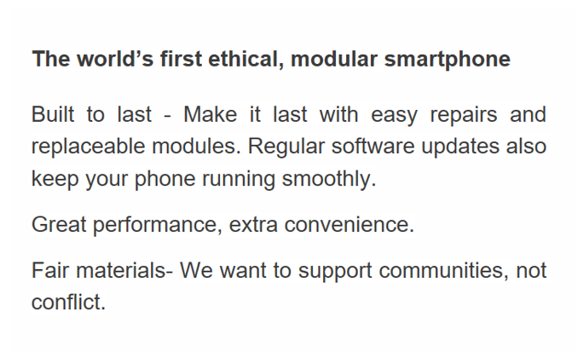
Same Product, Unique
Value
Proposition
Notes:
Iphone, Samsung, Fairphone

Slide 33
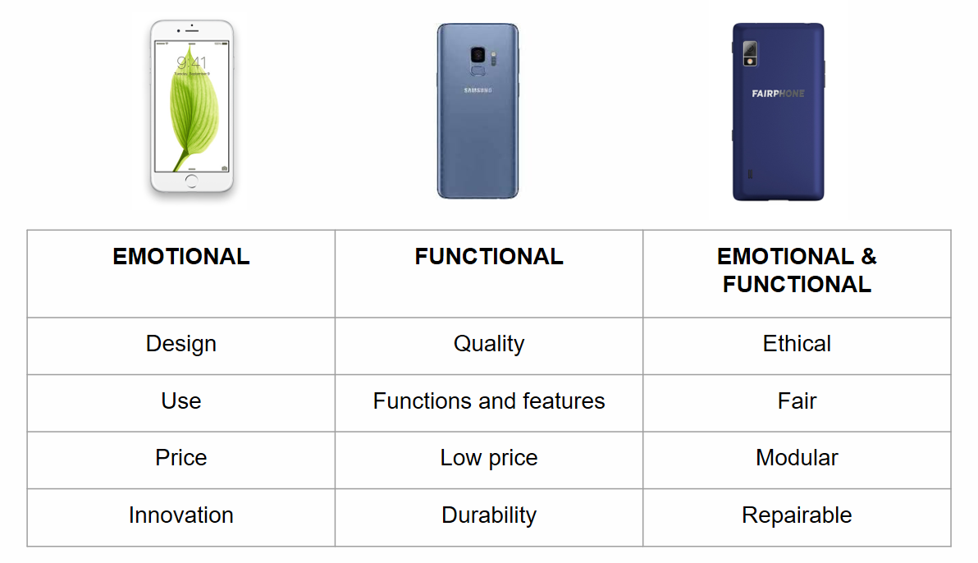
A Unique Value Proposition for the same Product
Notes:
Iphone, Samsung, Fairphone

Slide 34

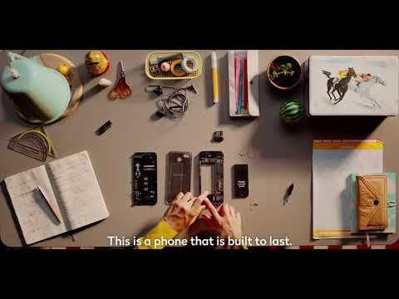

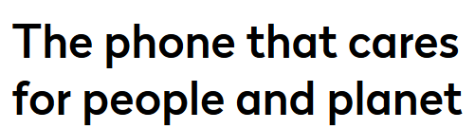
Notes:
-Watch the video
M - To build a fairer and more sustainable electronics industry.
V - Set new standards for the entire industry where consideration for people and the planet is a natural part of doing business.

Slide 35
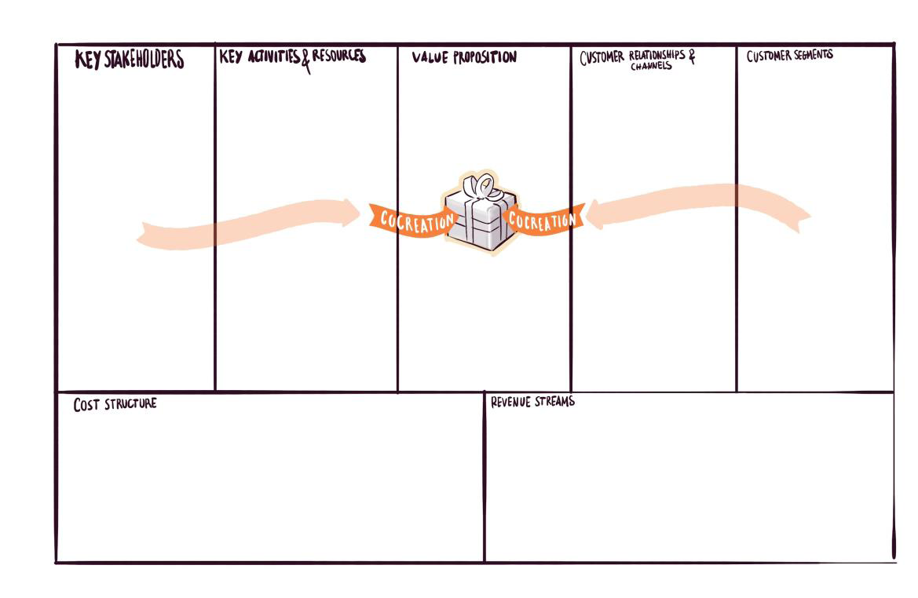
Formulate a Unique Value Proposition
At looking for opportunities to differentiate in the market, co-create with our clients and engage our stakeholders, we make sure that our value proposition is really positive, and that it matches with our clients’ needs and desires.
Notes:
-We should make sure that our VP creates environmental and social value addressing ecological and social challenges.

Slide 36
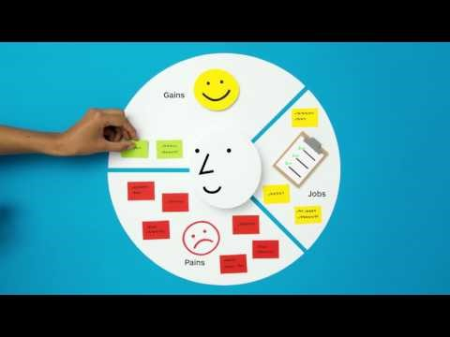
The Value Proposition
Canvas
Notes:
-Watch video

Slide 37
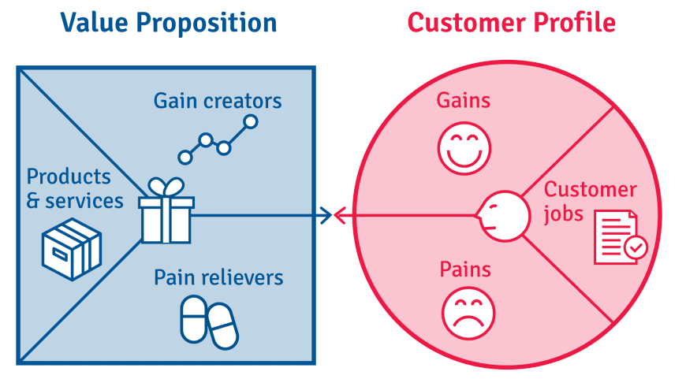
Formulate a Unique Value Proposition
Develop the Value Proposition on the basis of the work done so far:
Environmental and Social Value created by the business
Customers’ Pains, Gains and Functions
Let’s describe our products and services, how they relieve pains and create gains for each customer segment.
Describe our added value (compared to alternatives).
Notes:
-In “Exercise 9 – VP Canvas” on the Online Platform, we will have to describe:
Pains relievers
Gain creators
What our product/service do for the customers.
Functions
Added value in front of alternatives
Innovation value
… and synthetize our Value Proposition.
-Let’s keep in mind that in the Value Proposition, every adjective, element, functionality, performance, etc. represents a cost! → prioritise the most relevant attributes.

Slide 38
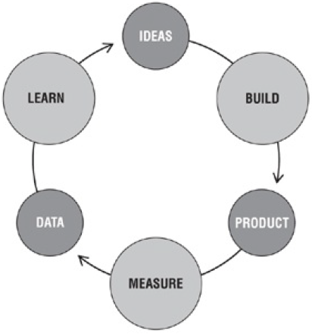
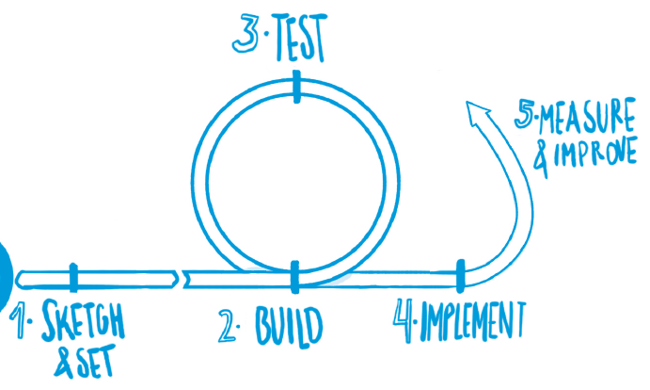
Test the Hypothesis and the Value Proposition
Why testing?
The more we test the closer we get to an ‘appropriate’ solution, thus reducing the risk of failure and up-front costs.
Testing will allow us to shape and re-shape the solution our business is trying to tackle and to validate the initial hypothesis on which it is build.
Ultimately it will help tailoring our value proposition to ‘real’ customer demands, needs and expectations; and to validate our business model.
So, as far as we can, we should test every step: whether the problems identified are correct, the means for stakeholder engagement, the segments, needs and expectations of our customers; the value proposition, and the price we expect to charge, etc.
Build-measure-learn feedback loop (Ries: 2011)

Slide 39
What do we need to test?
Focus on our business: is it relevant, innovative and competitive?
Relevance: idea that really satisfies a need. Enquiry our consumer about it.
Level of innovation: is a means to differentiation. Focus on the basics of our differentiation and test whether it is accepted. From this response we either improve or give up the idea.
Competitive: what price is our customer willing to pay for our product or service. It does not mean to be the cheaper. Instead the price reflects relevance and innovation and has to be optimal.

Slide 40
Tips for entrepreneurs
Our clients are not us. A common error is to believe that our customers will have similar taste, interests or needs than us. Often this is not the case, therefore we need to check it outside, in the real world.
Stay hidden is not an option. We must go out, test our product or service and get feedback from our potential customers as soon as possible. No matters whether the product or service is ready, we just pretend it is, and get information from potential buyers. It will help fine-tune it.
Make sure we know our client: who’s our client? What does he/she want/need? Can we contact him/her directly? How does he live? where?...

Slide 41
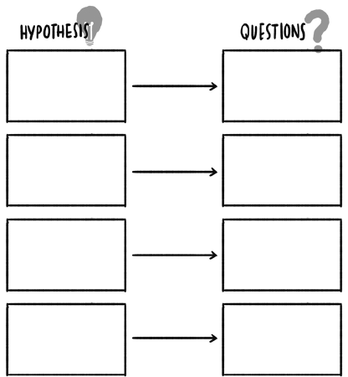
Design the Test
Design the test. We have to review our project, identify hypothesis which still need to be validated and formulate questions. Relevant issues that we may want to validate:
Objectives. Are those based on real problems and needs?
Customers. Segmentation, needs, aspirations, pains, profile, sensations, involvement.
Stakeholders. Identification (no one is missing?), involvement, gives and gets.
Value Proposition. Customers’ satisfaction and willingness to pay, market and competitors. To check the VP we may need prototypes.
Notes:
-In Exercise 10a on the Online Platform, we will have to design the test defining hypothesis (underpinning objectives, customers, stakeholders and the value proposition) and formulate questions

Slide 42
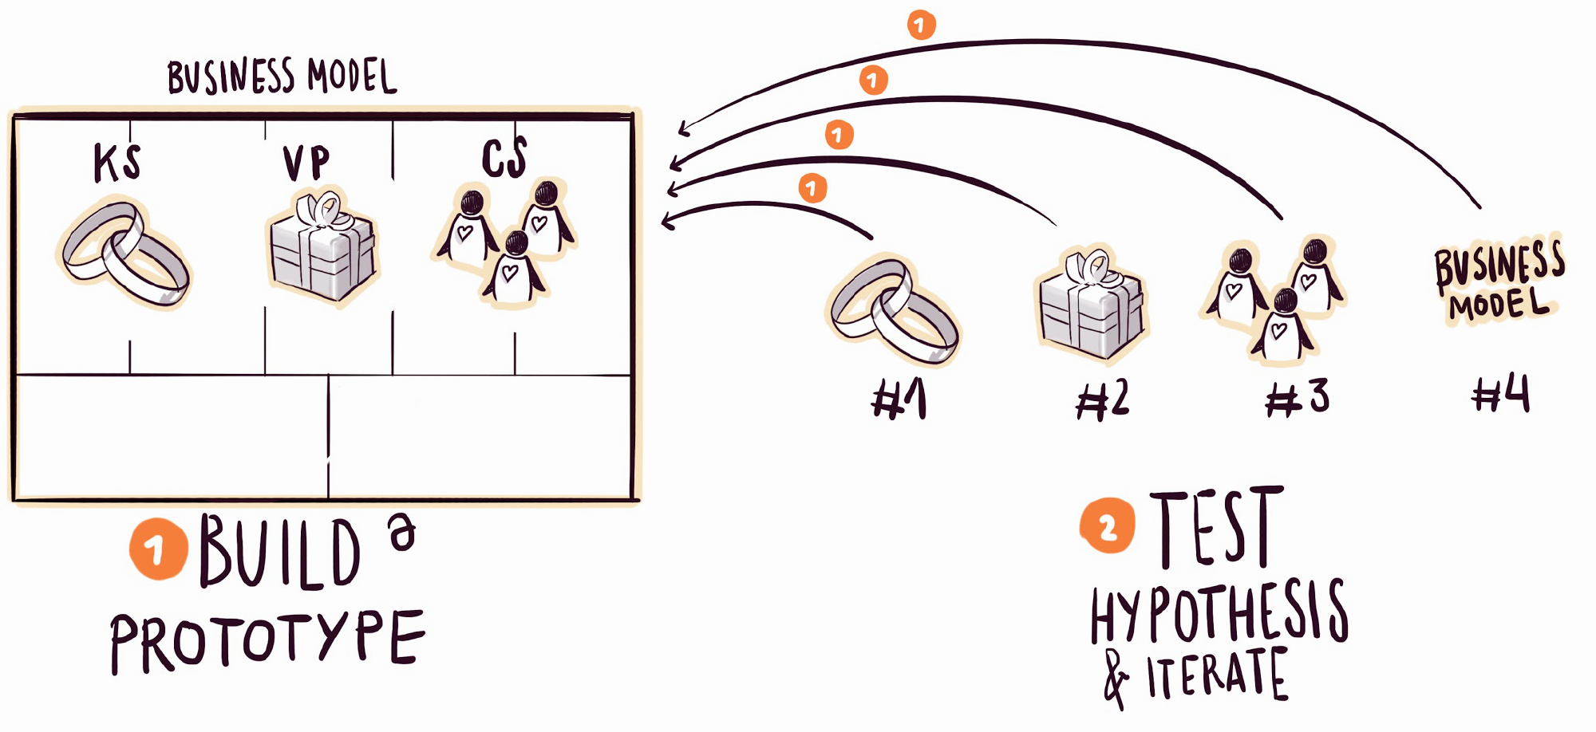
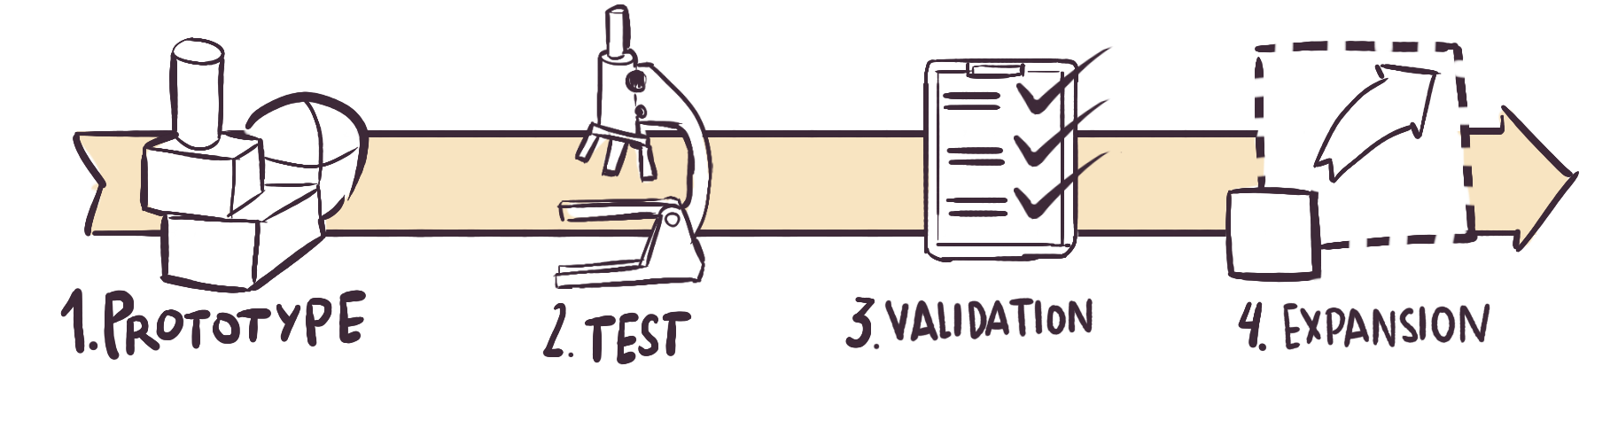
Carry out the Test
Select the best channels to reach customers and stakeholders (interviews, focus groups, observation, social networks…). Go out and talk to our customers and stakeholders and ask them about our questions. Validate the hypothesis or correct them, integrate the knowledge we have gathered with customers and stakeholders into our project.
If necessary, pivot our value proposition (or even reject the project).
Notes:
-In Exercise 10b on the Online Platform, we collect main finding and data gathered by conducting the test in a “discovery card”.
-In Exercise 11, if needed, we can modify our VP (as well as identified customers segments and stakeholders) according to the results and findings of the test.

Slide 43
Tips for trainers
This phase involves plenty of research by the green entrepreneurs. Make sure they take the necessary time and consult sufficient and reliable sources.
The value proposition is the essence of a business and so we have to help green entrepreneurs define appropriate tests to validate and improve it through co-creation.
Notes:
-Tests are very important to avoid risks and economic losses. Tests allow us to decide if is worthy to invest or not in the project.
-The GBM methodology suggests at least 2 tests (VP test and final test of the GBM prototype), but the more test we can do the better.

Slide 44
Homework:
Exercise 7. Identify and map the stakeholders
Exercise 8. Customer segments
Exercise 9. Value proposition
Exercise 10. Test
Exercise 11. Pivoting the VP
Notes:
Put yourself in green entrepreneurs’ shoes and fill in the exercises!

