Slide 1
Green Business Model
Training of Trainers
Country – Session 3
Trainer 1
xxx@mail.com
Trainer 2
xxx@mail.com
BSO

Slide 2
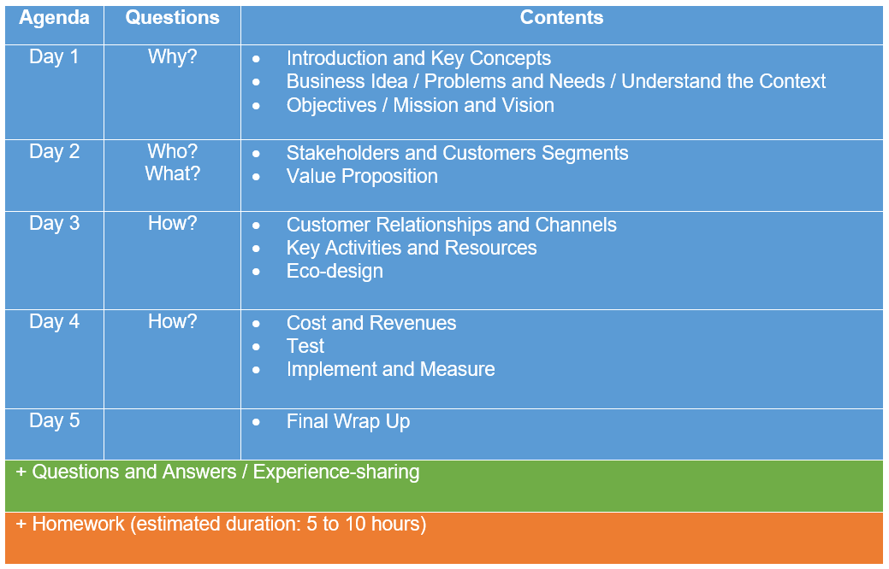
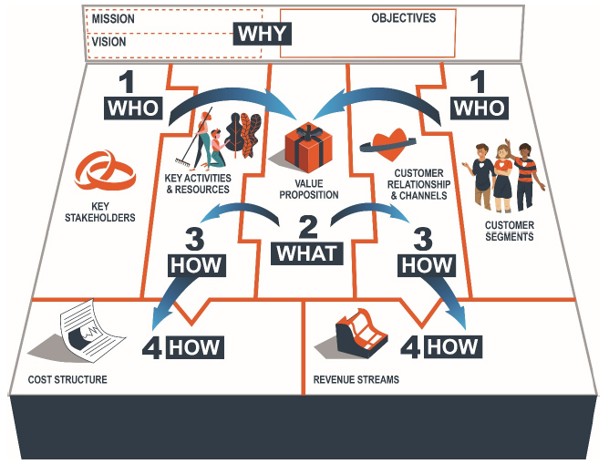
Agenda ToT

Slide 3
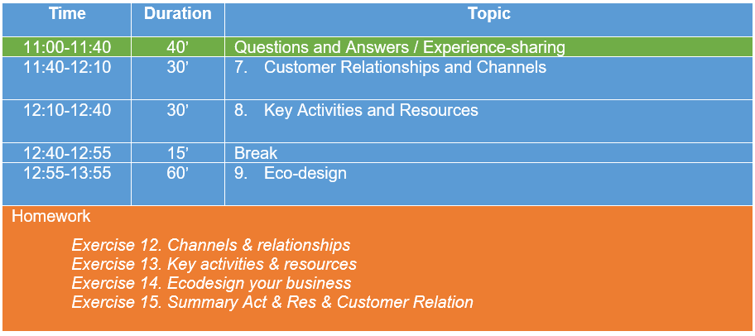
Agenda
Day 3

Slide 4
Questions and Answers
Experience-sharing

Slide 5
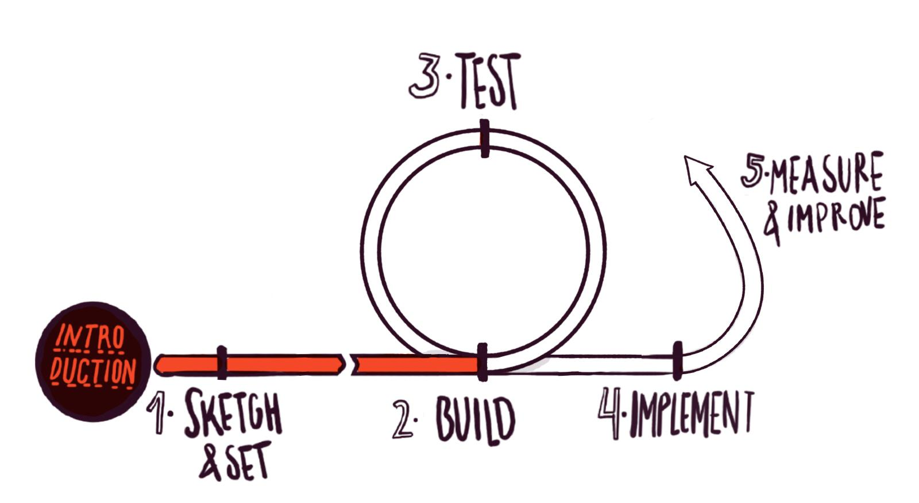
Methodological reminder
GBM as central design tool in each iteration with 4 main areas:
Who?: Stakeholders and Customers Segments
What?: Value Proposition
How?: Customers relationships and channels, and key activities and resources
How?: Cost structure and revenue stream
Green business’ direction has been set (Why?). Stakeholders and Customers Segments have been identified (Who?) and Value Proposition (What?) has been defined.
Now let’s start continue building the GBM by defining Customers relationships and channels and Key activities and resources (How?)...
Eco-design will allow us to improve the environmental performance of our product/service.

Slide 6
7. Customers Relationships and Channels

Slide 7
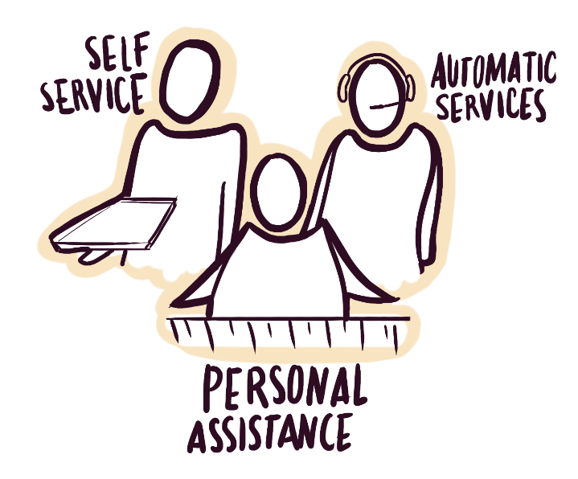
Customers Relationships
There are plenty of types of relationships a company can establish with a specific Customer Segment. Each of them define how it communicates, reaches and transfers value to each of them. The quality and level of detail paid on this relationship deeply influences the customer experience as well as the brand perception. Nurturing and tracking each touch-point your customer experiences is key to acquire brand loyalty and engage new clients. Along your brand experience, one or more of these types of relationships shall be established:
Personal assistance
Self-service
Automatic service
Community based
Co-creation
Notes:
-A company can establish many different kind of relationships with the customers.
-The type of relationship will allow us to reach and communicate with our clients as well as deliver them our VP
-Moreover, the type of relationship can also allow us to strongly engage customers and make them feel they are part of our business
-In this sense, the kind of relationship will deeply influence the customer experience and therefore their perception of our company
-Some of the main types of relationships are the following:
1. Personal assistance: we get involved personally in attending our customers, not delegating to other companies or machines. Example: a nurse, a teacher, etc.
2. Dedicated personal assistance: sometimes personal assistance is tailored for a few of our customers. They are special from the rest of our customers, so we attend them individually, with special care and dedication we do not provide to others customers. Example: an agent for actors/actresses.
3. Self-service: it means that the customer develops actions that generate the service he/she is expecting.
4. Automatic service: With an automatic service, the customer remains a passive subject and the service is provided by a machine.
5. Community based: relationships based on community rely on the force and inputs from all the members of the community.
6. Co-creation: by co-creation we engage our customers in the development of our service; they take an active part in its design and even its production.

Slide 8
Channels
Channels include all means of communication and distribution to reach customers and deliver a value proposition to them. A set of channels related to each customer segment (if they differ substantially) should be defined. Most of times, you will have to distinguish between the way to get the customer’s attention and how to establish and maintain a close relationship with them.
Communication channels (online and offline)
Distribution and sales channels (direct and indirect channels).
Notes:
-Concerning customer channels, they include all forms of communication as well as distribution and sales to reach customers
-For each customer segment we will have to define appropriate channels
-Commonly, GE will have to distinguish between how they will reach customers attention and how to establish and maintain the relationship
-Communication channels can be physicals or online
-Distribution and sales channels can be direct of indirect (e.g. if we work through intermediaries)

Slide 9
Environmental and Social added value
As Sustainable Business, we should try to allow that sales are not the only objective in the relationship with customers. Let’s try to define how the project also engages them in pursuing our environmental and social missions.
We should check how customer relationships and channels will prevent potential access barriers for people with special needs, most vulnerable people or marginalised groups.
Notes:
-Since we are a sustainable business, we should also pay attention to environmental and social added value of relationships and channels
-For example, ideally, sales should not be he only objective of our relationships with clients. The types of relationships can also be a strong mechanisms to engage customers in pursuing our environmental and social goals
-Considering relationships and channels we should also pay attention for example to prevent any potential access barriers for people with special needs or most vulnerable and marginalised groups

Slide 10
Customers Journey Map
The Customer Journey Map describes the journey of a user by representing the different touchpoints that characterize his/her interaction with the service or product. The interaction is described step by step, with emphasis on some aspects such as the flows of information and the physical devices involved. Mapping the customer journey represents a powerful approach for customer-centered action and innovation.
The customer journey is the complete sum of experiences that customers go through when interacting with your company and brand (from the moment that you realise that you need something, to the after-sale).
Entrepreneurs need to remember that creating a business is not about matching their desires and expectations, but satisfying customers’ needs.
Notes:
-In Exercise 12, the main activity GEs will have to undertake is to develop a Customer Journey Map for each customer segment previously identified.
-The map describes a user’s journey by representing the different touchpoints in his/her interaction with the service or product.
-Touchpoints cover all customer contact, from start to finish:
-how/when they become aware of our offer?
-how/when they compare our offer with competitors?
-how/when they finally decide to purchase our product/service?
-how/when they buy and receive our product/service?
-which are the after-sale touchpoints?
Etc.
-We should identify all touchpoints and if possible get real feedback from potential customers.

Slide 11
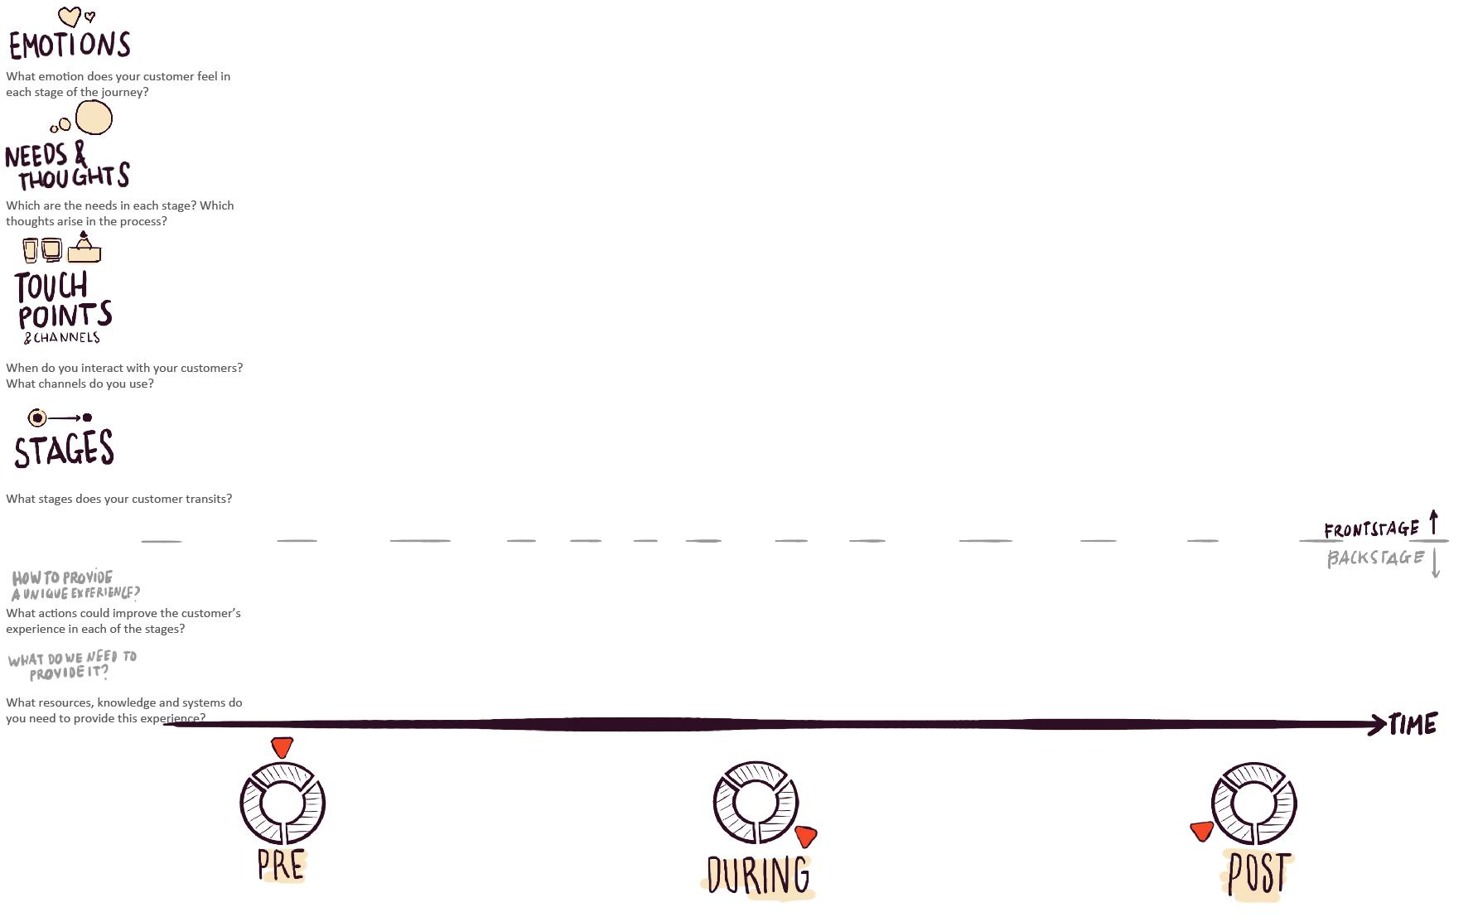
Notes:
-In Exercise 12 on the Online Platform, for each customer segment, we will insert the content and the customers journey maps will be automatically generated

Slide 12
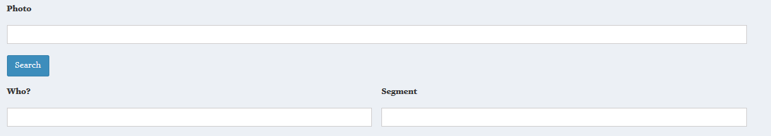
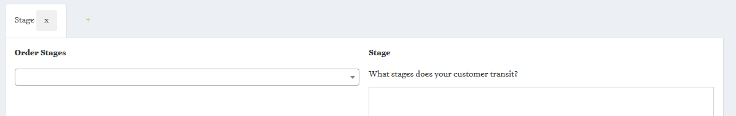
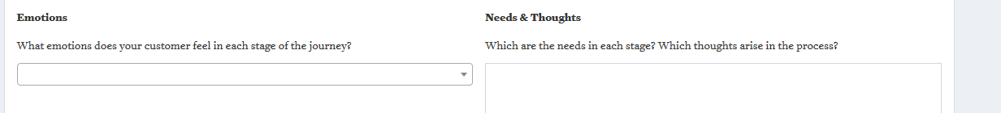
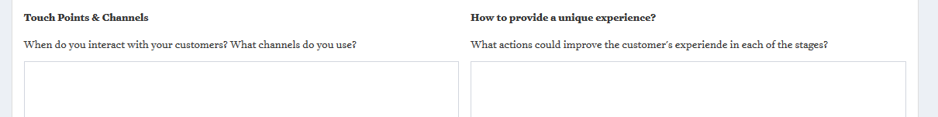
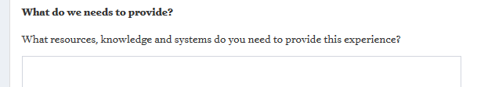
Notes:
-How to build the map on Exercise 12?
-First of all, we must define the customer and segment (add an image/picture if we want!) which we previously identified in Exercise 8.
Then, we fill in all the boxes which will shape this stage of the customer journey map:
“Order Stage": select if the stage is Pre, During or Post purchase.
"Stage": briefly describe the stage your customer transit.
"Emotions": define the emotions of the customer at this stage through an emoji.
"Need & thoughts": describe sensations and rational ideas of your customer at this stage.
"Touch Points & channels": describe touch points and means of contact between the service/product and the customers at this stage.
"How to provide a unique experience": define the actions to improve customer’s experience at this stage.
"What do we need to provide": describe the resources needed at this stage.
-We must create as many stages as needed by clicking on the add button (+) at the top of the Stage Tab (just to have an idea, a customer journey can be composed of around 5-10 stages). Stages can be deleted if needed.
-Once finished with a customer segment, we should select the following ones and start all over again to define each stage of their journey map.

Slide 13
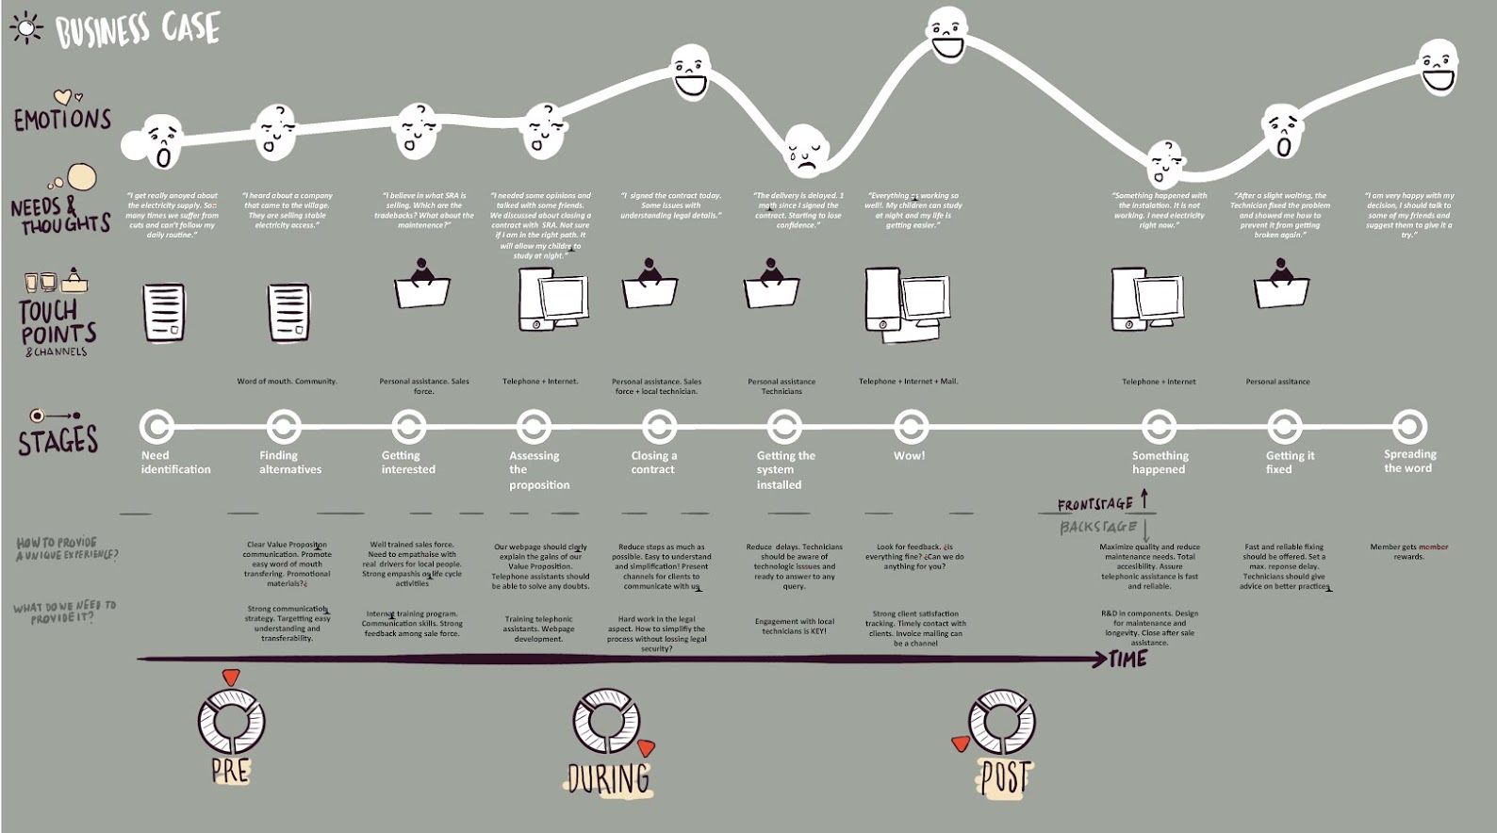
Notes:
-At the end of Exercise 12 the Tool will show us the journey of each customer segment identified.
-The idea is to progressively correct aspects that negatively affect customers by providing better alternatives and reinforce positive experiences

Slide 14
8. Key Activities and Resources

Slide 15
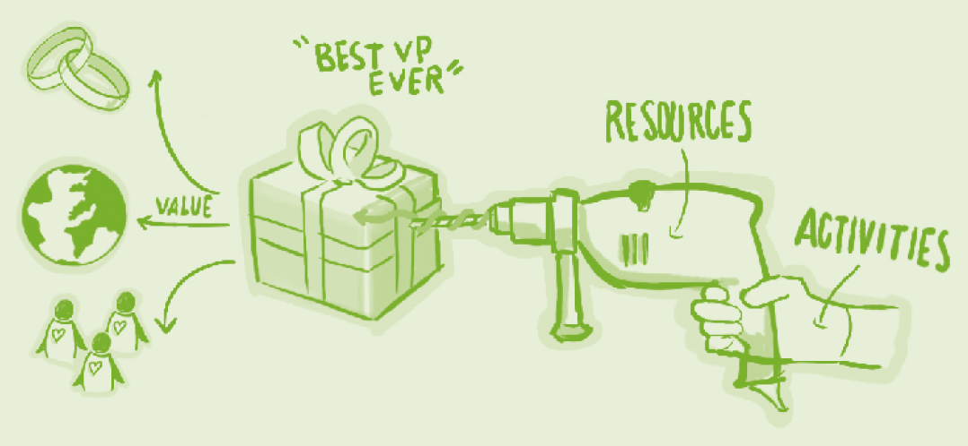
Key Activities and Resources
Key activities define what has to be done in order to define and offer a value proposition to a specific Customer Segment.
Key Resources comprise all the elements and aspects that are essential for making the business work properly.

Slide 16
Key Activities and Resources
Key Activities
Procedures, tasks and operations we need to do in order to offer the value proposition.
Kind of ‘to do’ list of actions organised by the different areas of our business.
For example, sales will include any activity that makes the commercialisation of our product ‘real’, such as marketing, mailing, social networking, fairs and events organisation and so on, with all the tasks and procedures they already included.
Key Resources
All the resources that are necessary to create value for the customer.
Resources which are considered an asset to a company, which are needed in order to sustain and support the business.
These resources could be human, physical, intellectual and financial.
Notes:
-KAs and KRs are all the tasks and resources we need in order to generate the value we are creating and delivering it to customers, other stakeholders and environment.
-In order not to miss anything, it’s usually useful to link activities with all the resources needed to fulfil them.
-All resources are then also linked with costs, we should identify and list them.

Slide 17
Key Activities and Resources: Environmental and Social added value
Human Resources. As defining our human resources structure, let’s foresee fair and equitable working conditions, beyond legal obligations. Production processes should guarantee safe and healthy conditions and environment, beyond legal conditions.
Material Resources. Healthy and safe. Give priority to local resources within production processes and operations.
Structure. Let’s opt for a legal form and an organizational structure consistent with the nature and objectives of a Sustainable Business, enhancing democratic and horizontal governance and ownership: cooperative, non-profit organization, social or green enterprise if our legal framework recognizes them, etc.).
Notes:
-Again, since we are a sustainable business, we should pay attention to environmental and social added value of KA and KR
-For example, considering HR we should ensure fair and equitable as well as safe working conditions, beyond legal obligations
-Considering material resources we can for example prioritise local resources
-And when assessing legal forms, we should opt if possible for an organizational structure which is coherent with our environmental and social mission, such as cooperatives, non-profit organizations or social and green enterprises if recognized by our legal framework

Slide 18
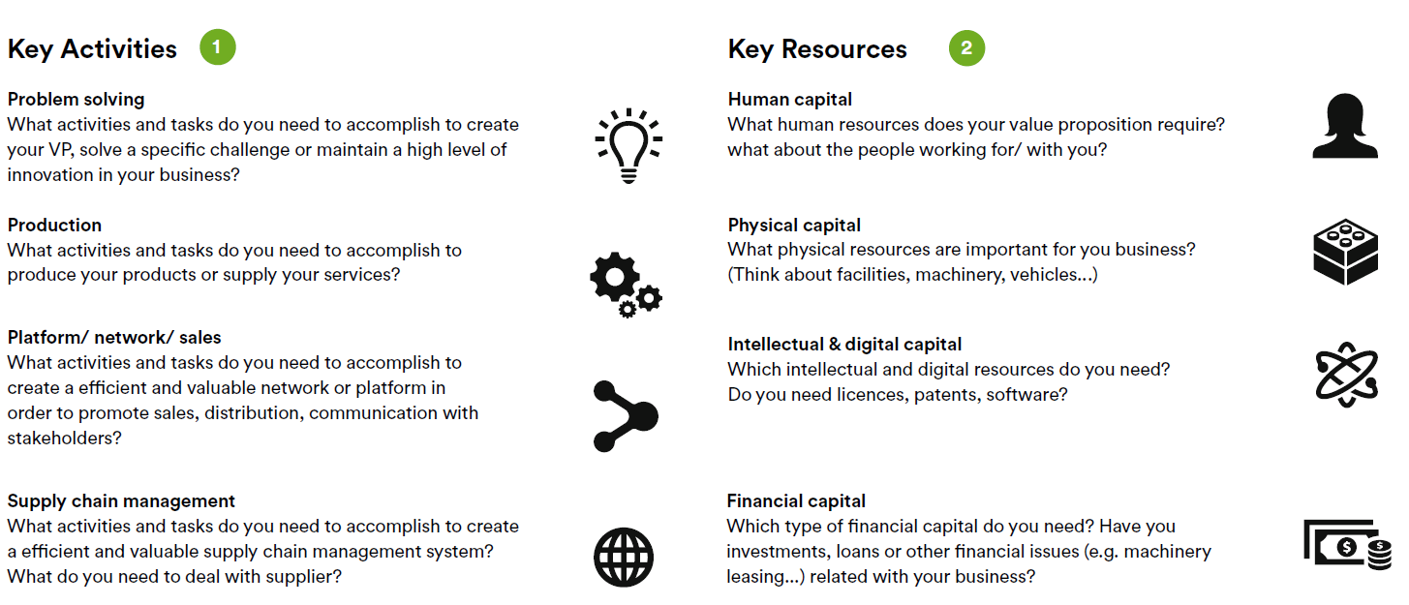
Notes:
-In Exercise 13 on the Online Platform, we have to list all key activities and key resources.
-The Methodology suggest the following categories to ensure that nothing is missing: see slide

Slide 19
Key Activities and Resources
The challenge is maximizing value for customers, stakeholders, and natural ecosystems, while minimizing economic, social and environmental costs.
Notes:
-The overall challenge on Exercise 13 is to maximize value for customers, stakeholders and the environment while minimizing economic, social and environmental costs

Slide 20
9. Eco-design

Slide 21
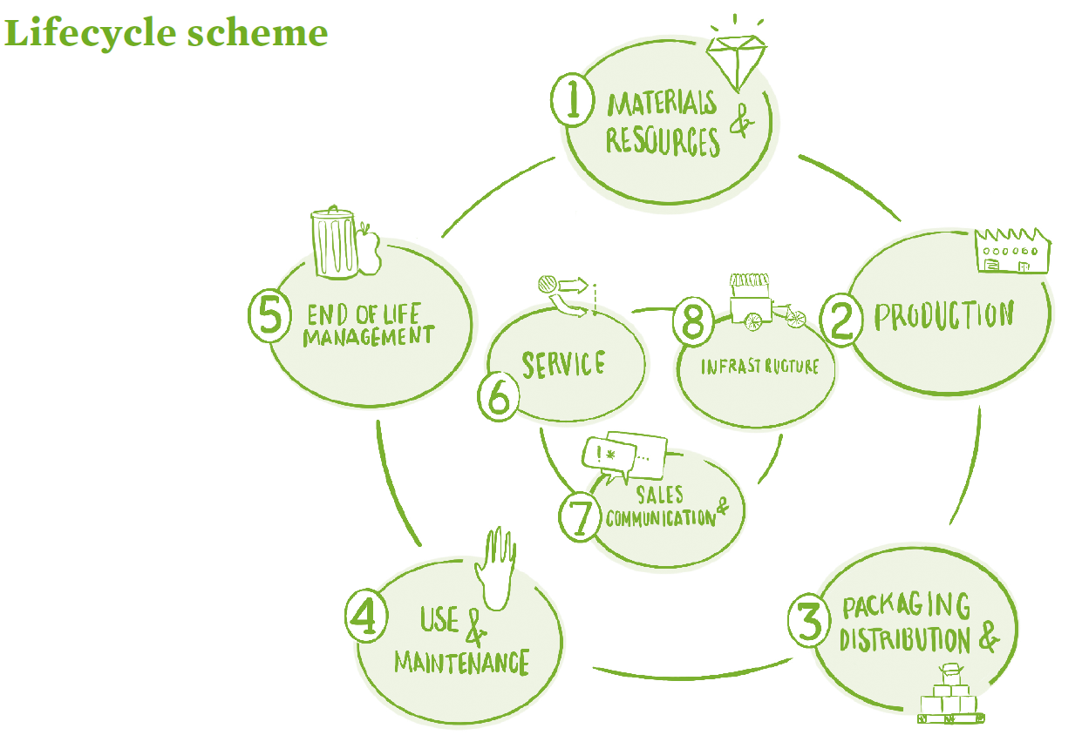
Eco-design
Eco-design helps us to effectively include environmental criteria in the design stage of our products, services and business models.
It allow us to minimise the negative environmental impact of our products and services, which are related to the necessary activities and resources, while generating more value for customers and stakeholders.
We have to systematically evaluate environmental impacts at all stages of the lifecycle of the product/service.
Notes:
-At Exercise 14 we eco-design our business.
-Eco-design is really the backbone of the methodology, giving the environmental uniqueness to the tool, and we thus have to support GEs to go through the exercise in an effective way.
-ED will allow us to include environmental criteria in all the steps of the lifecycle of our product/service.
-We will be able to minimise negative environmental impacts on each stage
-The methodology identify 8 stages for a product (and related services):
Materials and resources
Production
Packaging and distribution
Use and maintenance
End of life management
Service (related to the product)
Sales and communication
Infrastructure
For services, we will work on the last three stages

Slide 22
More than 80% of environmental impacts and costs of products and services are determined at the design stage.
Notes:
-As we mentioned on the 1s day, “more than 80%”… ED is therefore a key tool to reduce our potential negative environmental impacts

Slide 23
Why
Eco-design?
Contribute to the Environmental Objectives of our Project
Increase company resilience, e.g. mitigate risks from resource and energy scarcity
Increase resource and energy efficiency and productivity
Reduce costs and increase profitability and competitiveness
Compliance with environmental regulations
Access to growing markets for sustainable products and services. Image (ethical value)
Access to investments and public subsidies
Eco-innovation/differentiation. Increased internal capacities for innovation
…
Notes:
-Apart to reduce our environmental impacts and helping us to achieve our environmental objectives, there are many more reasons to ED our product/service, and ED can bring us huge added value.
-ED will increase our company resilience. Resource and energy scarcity is a growing threat resulting from environmental crisis
-ED will increase our resources and energy efficiency and therefore our productivity
-ED will reduce costs and therefore competitiveness
-ED will help us to comply with environmental regulations
-ED will allow us to access to new sustainable growing markets
-ED will help us to access to specific financial instruments and public subsidies
-ED will also increase our internal capacities for innovation, mainstreaming eco-innovation

Slide 24
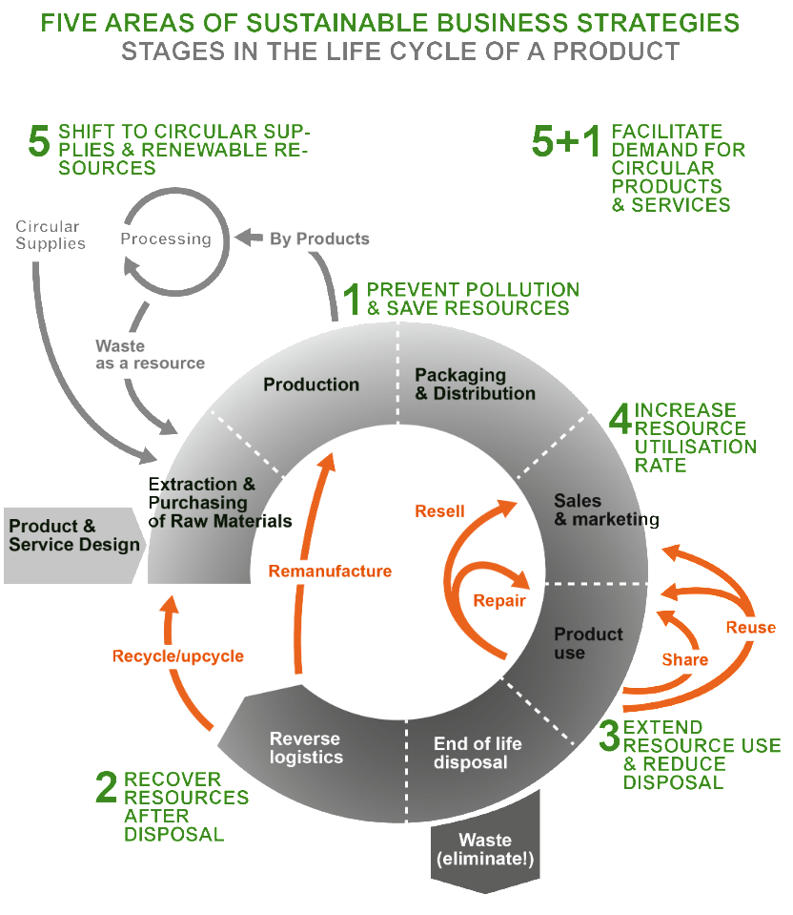
Eco-design
Applying circular economy strategies may help reducing the impact of the product/service
Notes:
-In general terms, from a conceptual point of view, along the lifecycle of our product, we can identify 5 main circular economy strategies to be implemented through eco-design:
We can prevent pollution and save resources
We can recover resources after disposal
We can extend resource use and reduce disposal (for example through reuse, repair…)
We can increase resource utilisation rate (for example through sharing systems and platforms)
We can shift to circular supplies and renewable energy and resources
-You will find additional info on this regard in the documents we sent you.

Slide 25
Product, service or both?
To apply Eco-design in the Online Tool, first we are asked if our value proposition is based on a product or a service. However, we shouldn’t that most of the time, a product is connected with its own service and the other way around. There is a deep interrelationship between products that need services to be sold and used, and services that need physical infrastructure and products to be delivered and used properly.
Notes:
-Now more specifically, what about the online tool?
-In Exercise 14 on the Online Platform: we have to select if we eco-design a product or a service.

Slide 26
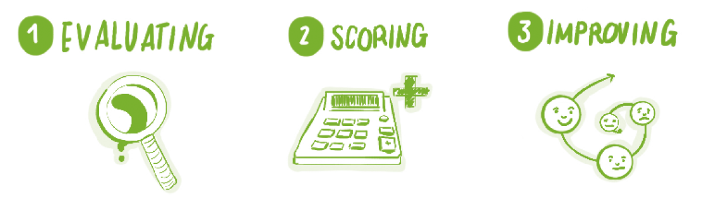
Three steps to Eco-design each stage of the lifecycle
Gather information and evaluating. Answering 5 main questions about different aspects of product and service lifecycle.
Scoring. Delve deeper into each of the 5 main aspects by answering a set of yes/no questions. The colour score system gives hints about the environmental metrics we can use to assess our environmental performance, communicate and compare results.
Improving - serves as a blank space to generate ideas that could be applied in our product or service to improve its score.
Notes:
-On Exercise 14 on the Online Platform, GE will have to go through 3 cards for each one of the 8 stages of the lifecycle (do you remember that we have materials and resources; production; packaging and distribution; use and maintenance; end of life; service; sales and communication; infrastructure) in the case of a service, the 3 last stages are assessed.
-Thanks to step 1/card 1 we will have a detailed description of the main elements of our product/service at this stage of the lifecycle
-On step 2/card 2 we will attribute a score to all these elements
-Finally, step 3 /card 3 will allow us to develop strategies to improve our environmental performance at this stage

Slide 27
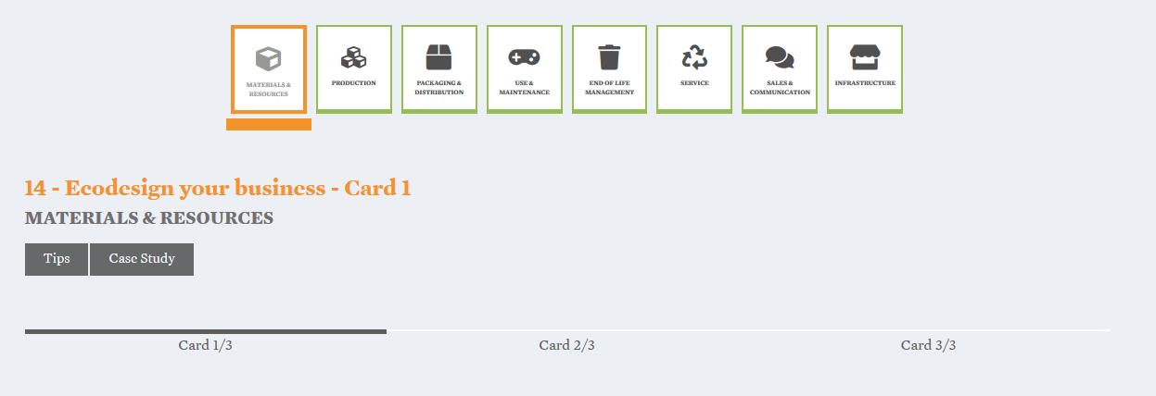
Three steps to Eco-design each stage of the lifecycle
Notes:
-As you will see in the online tool, at each stage, here for example “materials and resources”, 3 tabs are available corresponding to each step/card (evaluating, scoring and improving). The first time that a GE go through the exercise only the first 2 cards area available (evaluating and scoring)
-On Card 1 (evaluating) GE will have to answer to a set of 5 main questions describing the essential elements of its product/service at this stage. In order to properly answer the questions, the GEs are encouraged to analyse their idea and gather information about their product/service lifecycle. As said, the result of this first card is a detailed description of the main elements of our product/service at this stage.
-On Card 2 (scoring), GE will have to answer 3 y/n/o questions for each one of the main elements previously described. The platform automatically attributes a score (y=1 point, n/o= 0).
-Once we have finished with all lifecycle stages, a matrix with all the results is generated and Card 3 is now available for each stage in order to define strategies to improve our environmental performance and score.

Slide 28
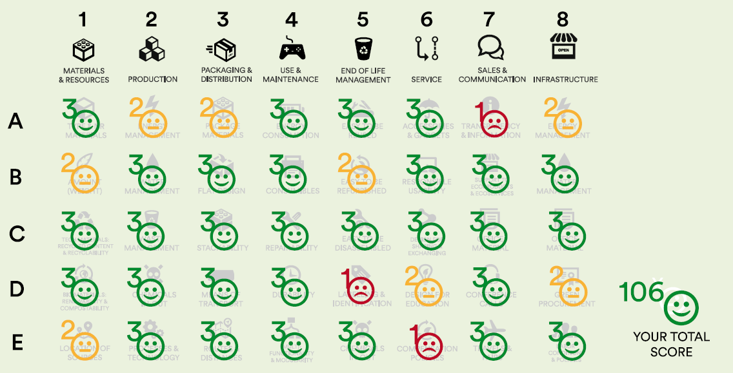
A tool for assessment…
Notes:
-The results of Exercise 14 show us the environmental performance for each one of the 5 identified aspects in each one of the 8 stages of the lifecycle, as well as our overall environmental performance.

Slide 29
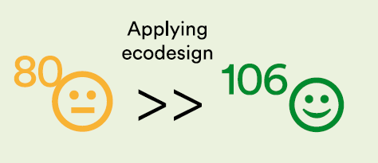
…and improvement!
Eco-design never ends, you can always get better and push the frontiers of eco-innovation further!
Notes:
-The results of Exercise 14 not only show us our environmental performance but they now give us the chance to improve our scoring in each block.
-We will have to stress the importance of this exercise and of the improvement of the score with the GEs since this is one of the most important parts of the methodology, ensuring the uniqueness of the approach giving centrality to sustainability.
-Cards 3 are now available for each stage of the lifecycle and we can access them by clicking in the icon of the lifecycle stage. The idea is to set up strategies to improve weaker aspects and by describing them we then adapt our score.
-In Exercise 15 on the Online Platform, key activities and resources and customer relationships and channels are reported and we can update and adjust them according to the learnings of the eco-design process.

Slide 30
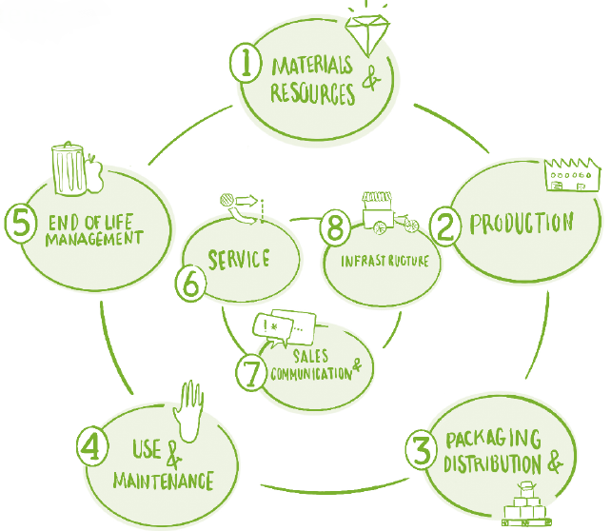
Eco-design strategies at each lifecycle stage
Materials and resources
Collaborative supply chain
Local, renewable, recycled, highly recyclable, eco-labelled… materials and resources
Avoid hazardous substances
Monomateriality
Design smaller and lighter product
Production
Most efficient processes and technologies: less energy/water and materials consumptive processes; less or no waste
Promoting artisan production, possibly, only on demand
Fewer processing steps
Promoting local and safe work
Notes:
-Since this is a very complex exercise, GE will need support and guidance from trainers and mentors.
-In the Tips box eco-design strategies are suggested for each stage of the lifecycle to help entrepreneurs: …
-The complete case-study can also help GEs in their ED process.

Slide 31
Eco-design strategies at each lifecycle stage
Packaging and distribution
Avoid unnecessary packaging or reduce it at the minimum
Optimise mass and volume transported (ISO size)
Reduce the amount of different materials + easy to separate
Returnable, biobased or reusable packaging
More efficient means of transportation
Reduce distances between production and consumption
Use and maintenance
Servitization, sell functionality instead of products
Modularity and design for maintenance
Using standard components to promote repairing
Increase energy and resource efficiency of products
Durability
Notes:
-Since this is a very complex exercise, GE will need support and guidance from trainers and mentors.
-In the Tips box eco-design strategies are suggested for each stage of the lifecycle to help entrepreneurs: …
-The complete case-study can also help GEs in their ED process.

Slide 32
Eco-design strategies at each lifecycle stage
End-of-life management
Simplification of product disassembly
Identification of the type of materials used
Reusability
Biodegradability
Recyclability
Energy recovery
Service
Collective/shared use of infrastructures, resource exchange
Promote sustainable behaviours and habits, co-create with users
Servitization
Design for all
Offset service emissions through specific programs and No profit initiatives
Notes:
-Since this is a very complex exercise, GE will need support and guidance from trainers and mentors.
-In the Tips box eco-design strategies are suggested for each stage of the lifecycle to help entrepreneurs: …
-The complete case-study can also help GEs in their ED process.

Slide 33
Eco-design strategies at each lifecycle stage
Sales and communication
Efficient use of resources
Avoid promotional travels
Watch out with fairs and marketing events, choose online options and sustainable events
Remote work for salesforces
Inform all the stakeholders about your environmental and social performance
Infrastructure
Use of low-impact and renewable energy sources
Efficient use of resources
Choosing cleaner processes
Ecolabelled suppliers or at least quality certified ones
Promote fairness, gender equality and integration beyond regulations
Notes:
-Since this is a very complex exercise, GE will need support and guidance from trainers and mentors.
-In the Tips box eco-design strategies are suggested for each stage of the lifecycle to help entrepreneurs: …
-The complete case-study can also help GEs in their ED process.

Slide 34
Homework:
Exercise 12. Customer Relationships and Channels
Exercise 13. Key activities & Resources
Exercise 14. Eco-design your business
Exercise 15. Summary Act & Res & Customer Relationships
Notes:
Put yourself in green entrepreneurs’ shoes and fill in the exercises!

