Slide 1
Green Business Model
Training of Trainers
Country – Session 4
Trainer 1
xxx@mail.com
Trainer 2
xxx@mail.com
BSO

Slide 2
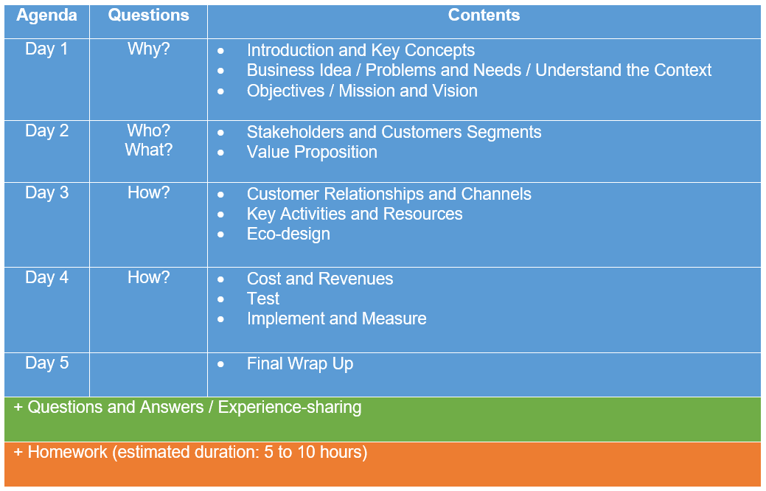
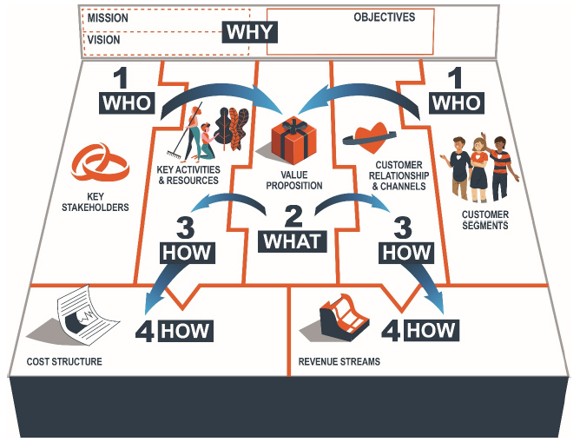
Agenda ToT

Slide 3
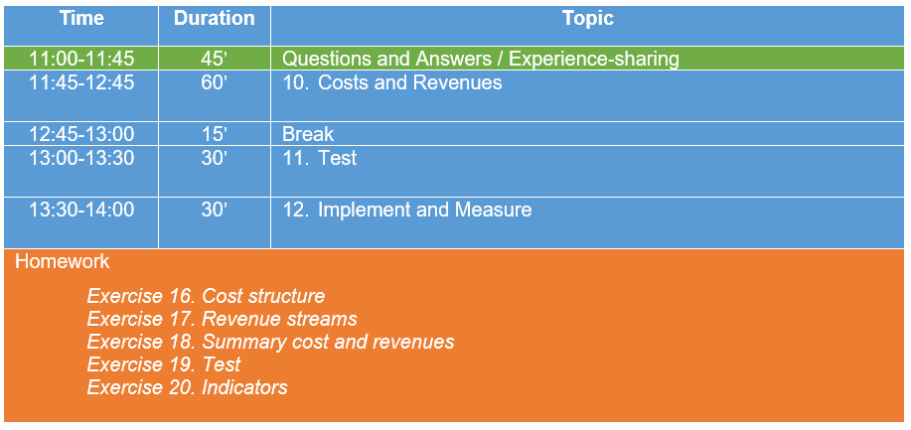
Agenda
Day 4

Slide 4
Questions and Answers
Experience-sharing

Slide 5
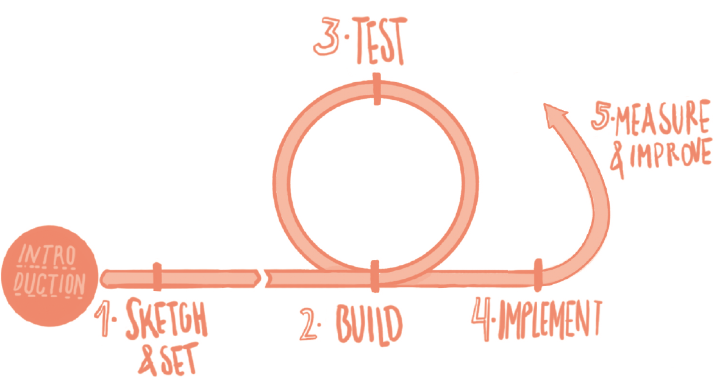
Methodological reminder
GBM as central design tool in each iteration with 4 main areas:
Who?: Stakeholders and Customers Segments
What?: Value Proposition
How?: Customers relationships and channels, and key activities and resources
How?: Cost structure and revenue stream
Green business’ direction has been set (Why?). Stakeholders and Customers Segments (Who?), Value Proposition (What?), Customers relationships and channels, and key activities and resources (How?) have been defined and eco-designed.
Now let’s calculate the costs of starting and running our project as well as our expected revenues (How?). The cost structure is not a financial plan, but a rough calculation about the costs of the implementation of the project. Finally let’s see how to Test and Implement our GBM as well as Measure and Improve our performance.

Slide 6
10. Costs and Revenues

Slide 7

Cost Structure
Direct vs. indirect costs. Direct costs are costs that can be identified directly with the production of a good or service; e.g. raw materials. Indirect costs are costs that cannot be matched against each product because they need to be paid regardless of whether or not the goods or services are produced; e.g. rent of the building/offices.
Opportunity cost. An opportunity cost is the loss of potential gain from other alternatives when one alternative is chosen. A business can measure the outcome of a decision by comparing it with the benefits (probably measured in profits or revenue) it could have had if it had taken the next best option. The opportunity cost of buying a new piece of machinery might be compared with the benefits of spending the money on a new advertising campaign, for example.

Slide 8
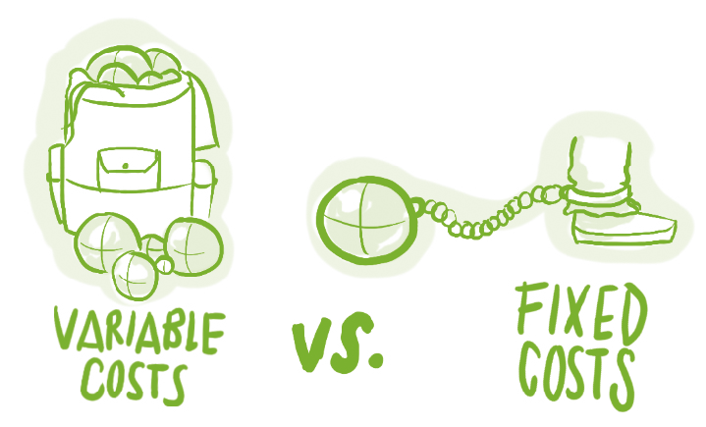
Cost Structure
Let’s try to keep a well-balanced cost structure. The more costs we can put on the variable costs side, the better!
Fixed costs: Costs that remain the same no matter the volume of goods or services produced. Salaries, rents, heating, lightning, physical manufacturing facilities...
Variable costs: Costs that change in proportion of the volume of goods or services produced. Production materials and energy, distribution costs, outsourced human resources…

Slide 9
Cost Structure
The cost structure is directly related to the key activities and resources which in turn are related to the value proposition. If something is not affordable, we can go back and revise the activities and resources which have been defined. This is an iterative process that may have an effect on the entire business model.
Notes:
-Costs mainly come from resources, channels and VP.

Slide 10
Cost Structure Environmental and Social added value
Avoid significant wage disparities while estimating human resources costs.
Have you assessed potential environmental and social negative impacts and costs of your activities? If any, how will they be remedied?
Have you weighed potential environmental and social negative costs against the expected social benefits of the initiative?
Notes:
We can’t forget to assess our environmental and social costs!

Slide 11
Cost Structure
Let’s introduce and estimate all our costs into the Online Platform
Notes:
-In Exercise 16 on the Online Platform, we have to list and estimate all our costs: investment, fixed costs and variable costs.

Slide 12
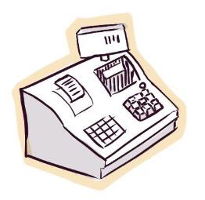
Revenue Streams
Revenue streams are essential in your business and they can be generated in many different ways

Slide 13
Types of revenue streams
Asset sale. An asset sale is classified as such if the seller gives the buyer absolute control of the property of the product after payment is made. In other words, the product is transferred from one pair of hands to another with payment made in return.
Usage fee. The use of a particular service is sold, the amount paid depending on the usage. For example, an eco-lodge charges customers for the type of room and nights occupied.
Subscription fees. Here, a continuous or repeated access to a service is sold. A gym sells its members a monthly or yearly subscription for access to its exercise facilities.
Lending/Renting/Leasing. The revenue stream is created by granting someone the exclusive right to a particular asset for a fixed period in return for a fee. Lenders receive recurring revenues, and lessees pay a fraction of the full cost of ownership. Rentals (cars, cottages, farm machinery, etc.) are common examples.
Notes:
Some revenues are better: stable cash flow. The business ensures a regular entrance of money, a monthly fee for example. It is better than depending on the sales of a specific asset.

Slide 14
Types of revenue streams
Licensing. Here the content owners retain copyright while selling licenses to third parties. Media companies obtain their revenues in this manner, as do patent-holders of particular technologies.
Brokerage fees. Revenue here derives from an intermediation service performed on behalf of two or more parties. Brokers and real-estate agents earn a commission each time they successfully match a buyer with a seller. A green entrepreneur can be the intermediary and connector between organic farmers and consumers, providing a platform that makes transactions easier, while gaining a commission each time a transaction is completed.
Advertising. Fees for advertising a particular product, service or brand form the basis of this revenue stream. Newspapers and the media industry generally rely on this approach, which has spread to website advertising and software sales.
Notes:
GEs should explore servitisation and the change in the GBM and revenue streams that it represents. The asset property stays with the company instead of the customer. It implies that the company controls the life cycle of the product which is easier in terms of maintenance and elongating their time span.

Slide 15
Revenue Streams Environmental and Social added value
We have to make sure that our company will generate important environmental and social value besides economic revenues.
Can we plan to invest part of our profits for the benefit of workers/members, the community wellbeing and/or the environment?
Can we plan to invest economic surplus or benefits in ethical finances?
Will we adopt a legal form which promotes the investment of profits and surplus according to social and environmental criteria (cooperative, social and solidarity economy entity, non-profit organization, social or green enterprise, etc.)?

Slide 16
Revenue streams
Let’s introduce our expected revenues into the Online Platform
Notes:
-In Exercise 17 on the Online Platform, for each product/service we have to select a revenue model and estimate the price, as well as describe the essential characteristics of our revenue model.
-Exercise 18 will summarize our cost structure (fixed and variable costs, financing), revenue stream and economic value creation.
-The costs and the revenues will provide an estimation of the number of products we have to sell annually or the number of any other revenue stream that we have to generate in order to cover our costs. It is important to bear in mind that this exercise is an estimate, as in the next phase (GBP) we will develop a proper financial plan.
This is also an information that we will have to test, in particular, the revenues, in order to assess whether our customers are willing to pay the amount we estimated.

Slide 17
Our GBM Canvas is completed!

Slide 18
11. Test

Slide 19
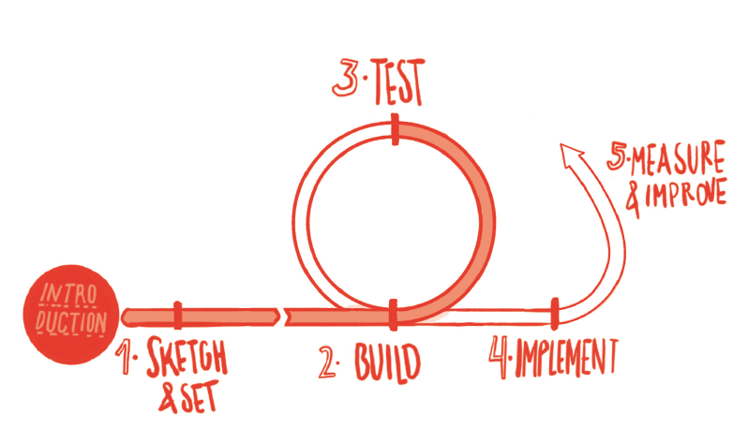
Test the Green Business Model
Now it’s time to test and validate our business solution in the market. Let’s test the prototype in order to validate the hypothesis for each key part of the GBM (prices, revenues, customers willingness to buy and to pay...). Through multiple iterations, in increasingly real market conditions, we can refine our prototype until we reach an optimal solution that is market-fit and creates maximal environmental and social value.
Notes:
The GBM methodology suggests at least 2 tests (VP test and this final test of the GBM prototype), but the more test we can do to validate hypotheses at any time of the development of the GBM the better.

Slide 20
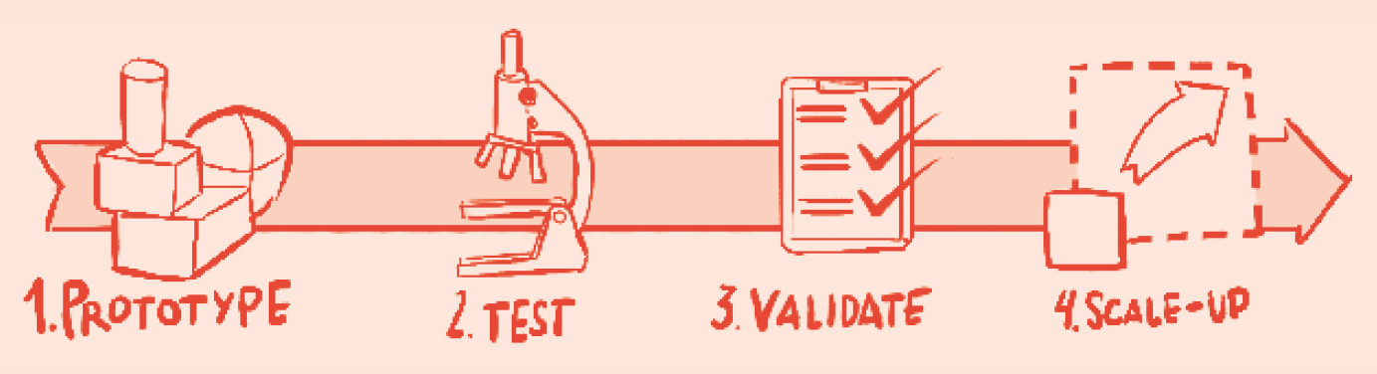
Test the Green Business Model
Once we have a prototype (GBM) it’s time to test hypotheses, validate the results and progressively scale up these tests. Through multiple iterations, in increasingly real market conditions, we refine our prototype until we reach an optimal solution that is market-fit and creates maximal environmental and social value

Slide 21
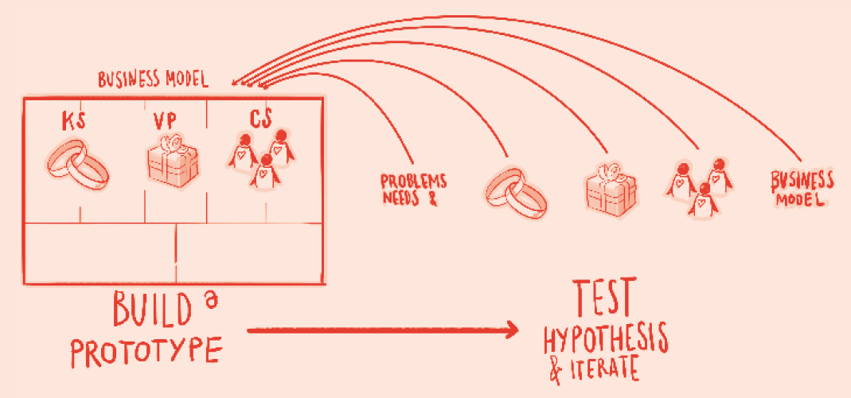
Test the Green Business Model
Five fundamental elements require validation: problems and needs; customers segments; stakeholder engagement; value proposition; business model.

Slide 22
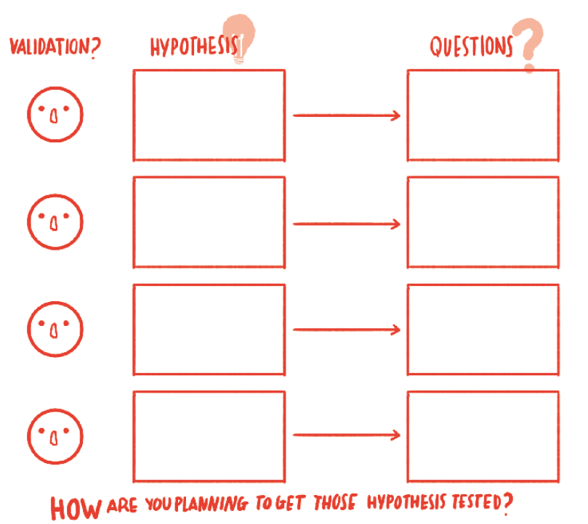
Design the Test
Identify and prioritise the hypotheses (structured around the five main areas of the GBM)
Define the questions and how to test (interviews, observation, focus group, sale, etc.)
1 test for each area or for several areas at once (VP, business model…)
Each test uses its own metrics and can be run in a number of iterations, as we increasingly approach real market conditions.
For the last element (business model), we add prices/rates. The tests are thus selling or pre-selling mechanisms, or even small pilot projects, always with a price signal and a cost estimation.
To be operational our solution has to be scaled up from prototype to the optimal market size where viability is attained (product-market fit).
Notes:
-In Exercise 19a on the Online Platform, we design our test adding as many hypothesis and questions as needed and defining how do we plan to test the hypothesis.
-The test is similar to the previous one but is more focused on the final product/service, thus the value proposition, and the revenues (both streams and prices) rather than on the initial hypothesis.
-This test should be more practical than the first one. We should go out and ask questions, think on how we will get the information and do it.
-We should not ask the same questions than in the first test, as the value proposition is already adjusted and tailored to the findings of the first assessment.

Slide 23
Validate results and scale up
Let’s run the test and gather information on the satisfaction customers have about our product/service and other results:
If hypotheses are proven wrong we need to change them and adapt the GBM building a new prototype
If the hypotheses are proven right we are on the right track to scale up
When all hypotheses have been validated, we can move to the last stage of the testing phase: scaling-up. It consists of increasing the testing level to closer-to-market conditions to render viable and operational our GBM and reach optimal market size.
Notes:
-In Exercise 19b on the Online Platform we will gather main learning and results after conducting the test.
-Exercise 19c will allow us to quantify customers satisfaction observed during the testing.

Slide 24
12. Implement and Measure

Slide 25
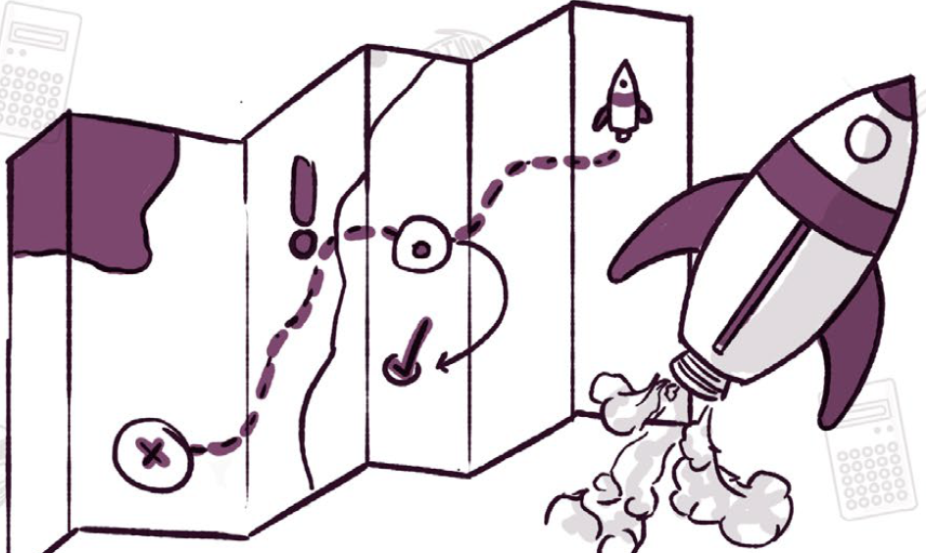
Sustainable Business Planning
Once the GBM has been successfully validated, it’s time to plan the development and management of our business and proceed with operations.
Among the major elements which we will have to plan:
Operation and Management Plan
Marketing Plan
Financial Plan
Legal Management Plan
Roadmap to launch the business
A specific step-by-step Tool for Sustainable Business Planning is available into the Online Platform.

Slide 26

Measure and
Improve
In order to measure the impact and the real value created by our business we have to define easy-to-measure, effective and functional indicators.
Project Indicators will track how we are doing regarding the achievement of our objectives and mission: 1) Environmental Challenges; 2) Social Challenges; 3) Customer Needs; 4) Team Motivators
In addition, specific Environmental Performance Indicators will measure our ecological impact.
A specific Impact Monitoring Tool is available into the Online Platform.
Notes:
-In Exercise 20 on the Online Platform, we will have to define Project and Environmental Performance Indicators.
-Environmental and social objectives being the main purposes of a sustainable business, impact measurement becomes an essential element of our project.
-By assessing our impact with Indicators we can initiate a cycle of continuous improvement and ameliorate every aspect of our business.

Slide 27
Homework:
Exercise 16. Cost structure
Exercise 17. Revenue streams
Exercise 18. Summary cost and revenues
Exercise 19. Test
Exercise 20. Indicators
Notes:
Put yourself in green entrepreneurs’ shoes and fill in the exercises!

