Slide 1
Green Business Model
Training of Trainers
Country – Session 5
Trainer 1
xxx@mail.com
Trainer 2
xxx@mail.com
BSO

Slide 2
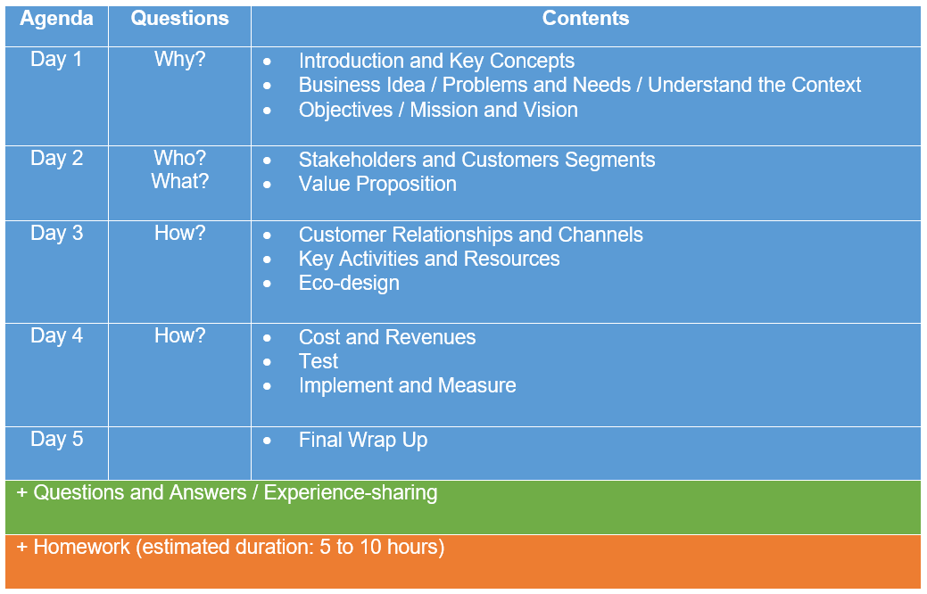
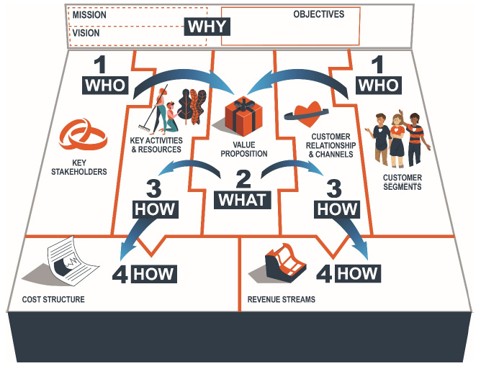
Agenda ToT

Slide 3
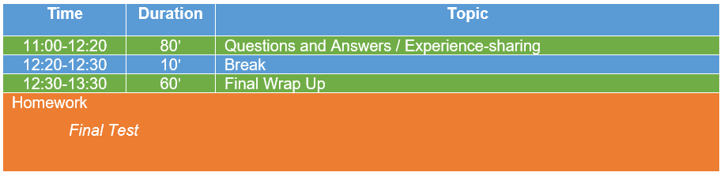
Agenda
Day 5

Slide 4
Questions and Answers
Experience-sharing

Slide 5
Homework:
Final Test
Notes:
Put yourself in green entrepreneurs’ shoes and fill in the exercises!

Slide 6
        NEXT STEPS
ToTs for the rest of the tools:
  GBP and Impact Monitoring Tool
  Eco-design
  A2F and A2M
Training for GEs under Switchmed and the National Partnership (management through the Online Platform + Pedagogical Guide)
Evaluation test and certificate of approval.
Replication and transfer of the methodology to other members of the BSOs.

